Slide 1
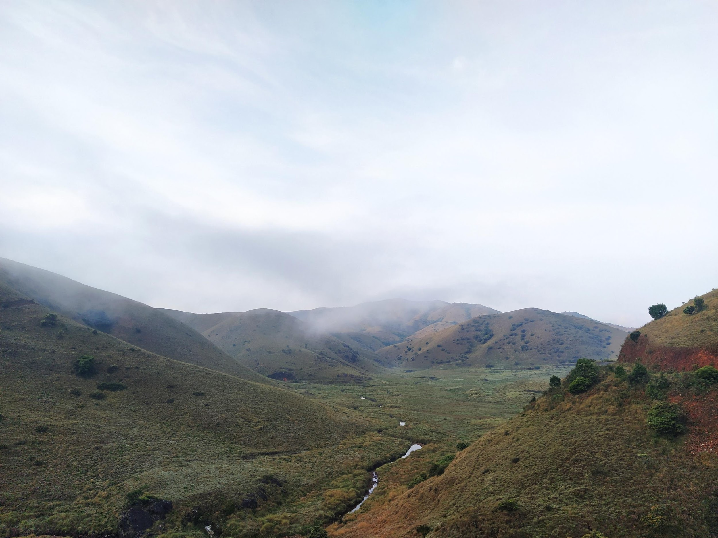


Spatial analysis using R
Vijay Ramesh
Columbia University
vjjan91
vr2352@columbia.edu

Slide 2
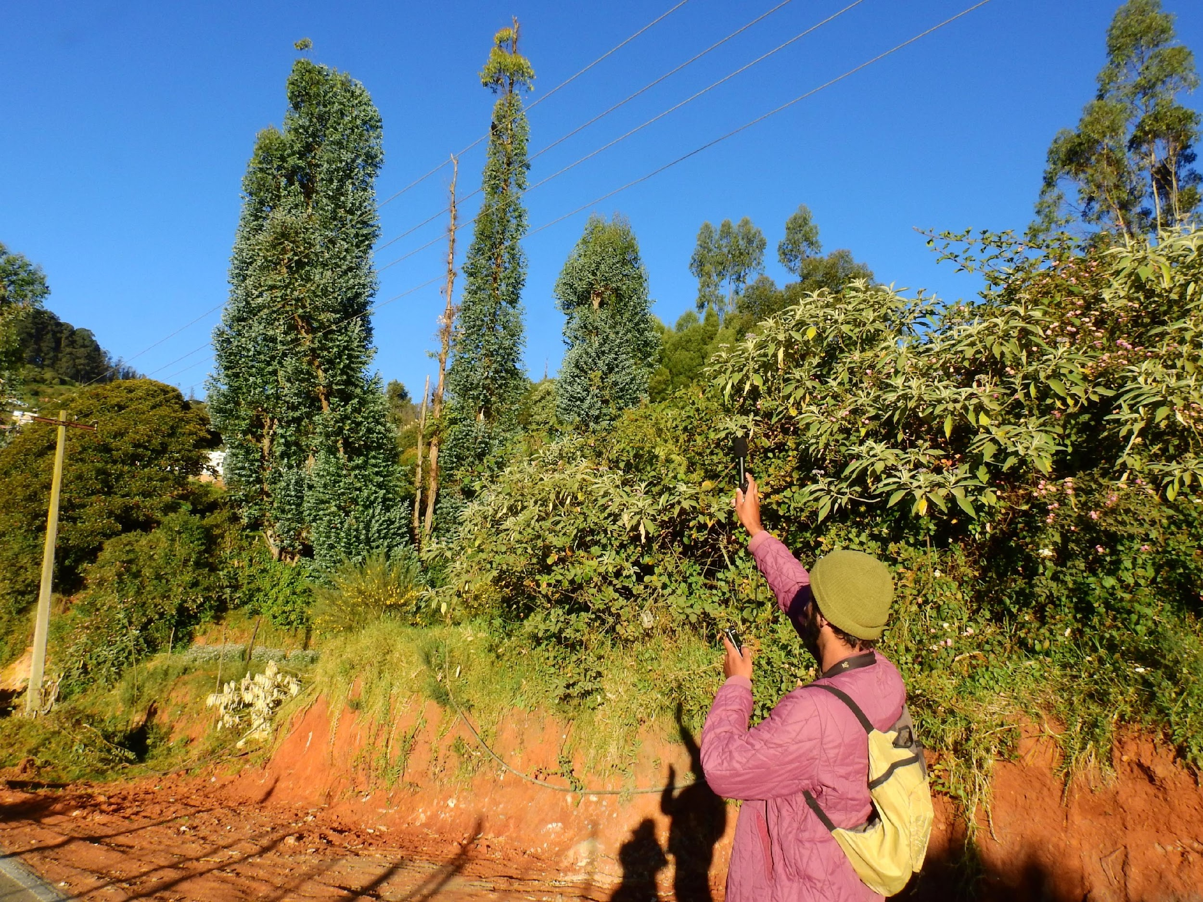
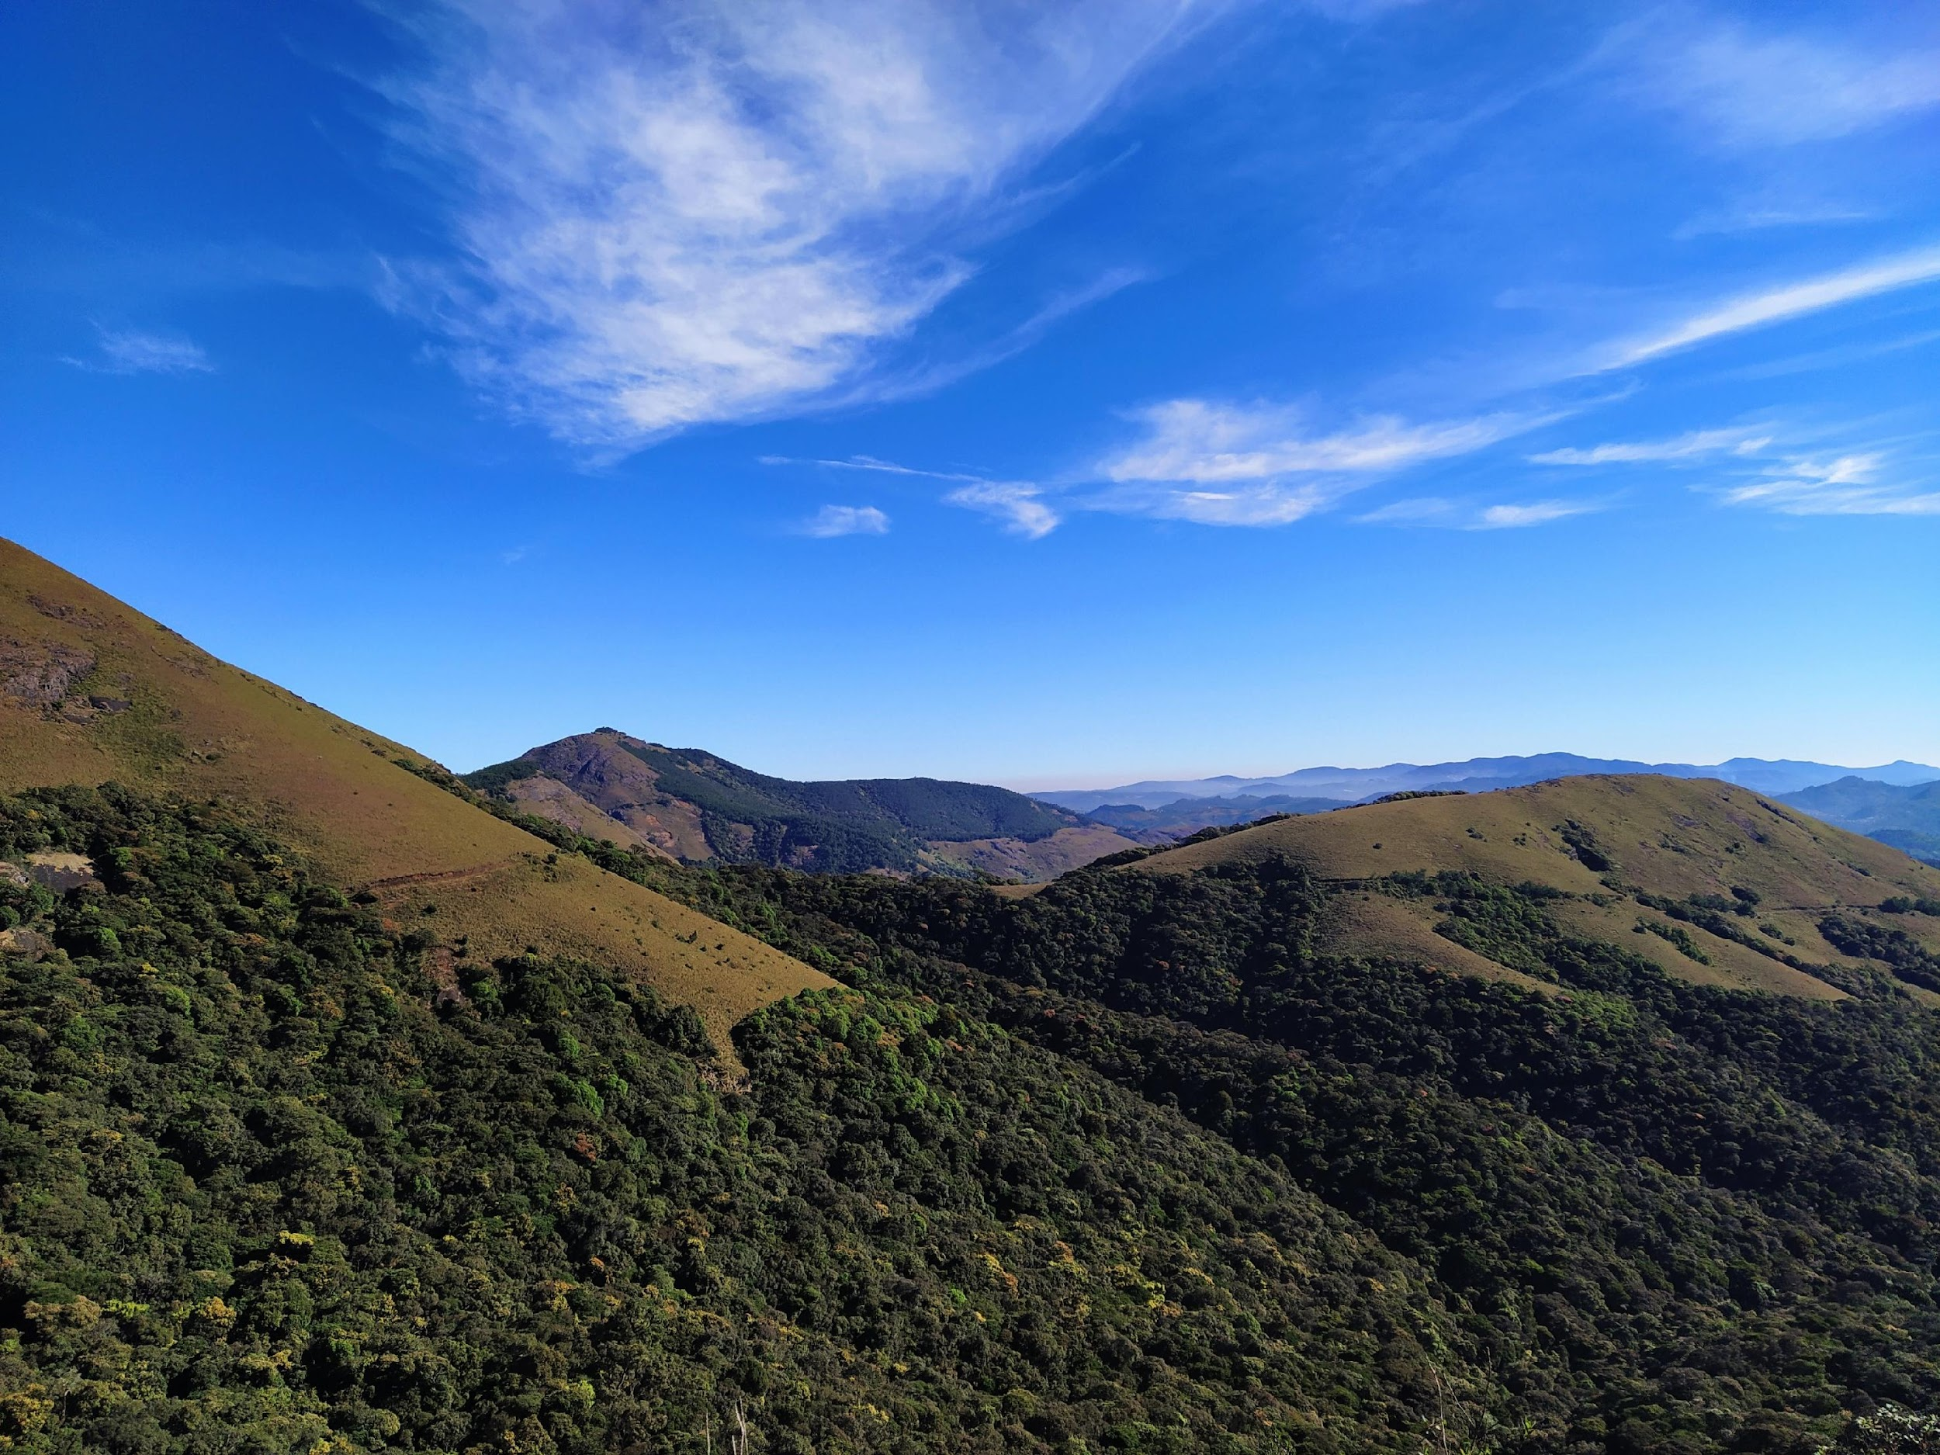
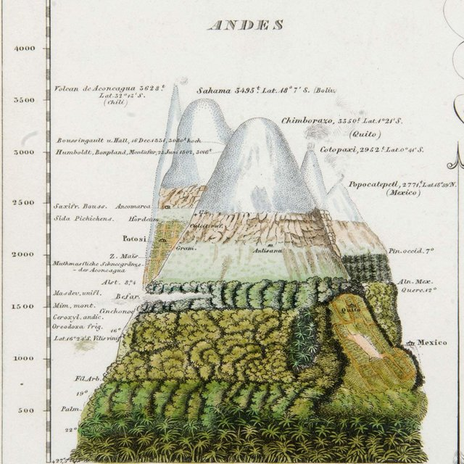

Community assembly along elevational gradients
Environmental factors
The Nilgiris – a unique, understudied elevational gradient
Integrative research – community ecology, bioacoustics, citizen science
Humboldt 1807; Cavender-Bares et al. 2009; Graham et al. 2014
Notes:
While working in the Nilgiri hills, I started thinking about how birds are distributed along this elevational gradient and how the environment………
Most studies have relied on community ecological approach, but the strength in combining these two can provide a better understanding of community assembly patterns

Slide 3

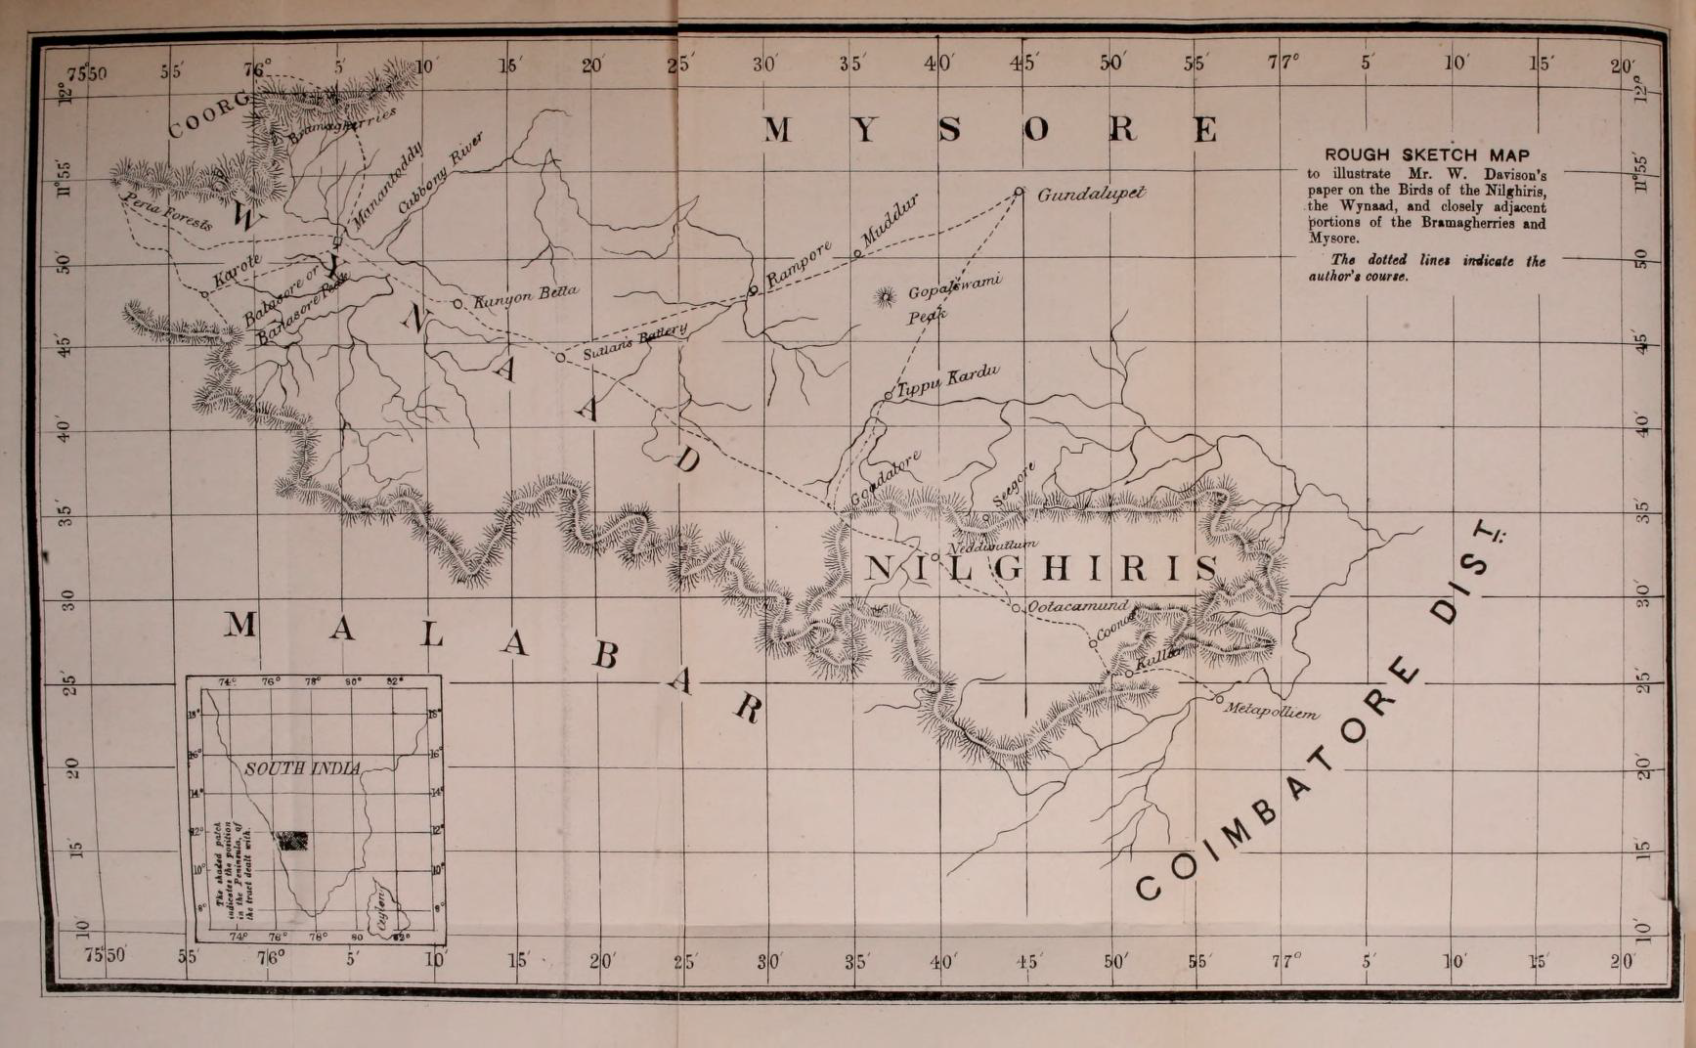

Themes of research

Slide 4
Today’s agenda
Spatial analysis using R
examples of existing packages and functionality
Case study from the Western Ghats
Reproducibility
Using GitHub + Rstudio
Using your own data?

Slide 5
Why spatial analysis?
Pattern and Process (Landscape Ecology)
Visualization?
What’s the question you want to answer? Will spatial data or spatial analysis help answer your hypothesis?

Slide 6
Recap: What are Vectors and Rasters?
Vector data tends to dominate the social sciences because human settlements and boundaries have discrete borders.
Raster data often dominates the environmental sciences because these often use remotely sensed imagery.
http://robinlovelace.net/geocompr/spatial-class.html
Image Courtesy: MIT OpenCourseWare
Notes:
Vector data tend to be dominated by points, lines and polygons, whereas raster data is in the form of rows and columns (or a matrix) / grid. / continuous data. Rasters can include elevation models, values for vegetation indices, land cover. Majority of these datasets have attribute tables associated with them.

Slide 7
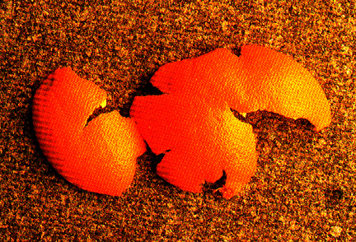
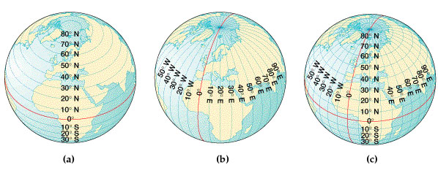
Recap: Coordinate Systems and Transformations
Tradeoffs – Preserve shape or area ?
http://krygier.owu.edu/krygier_html/geog_353/geog_353_lo/geog_353_lo05.html
Notes:
One can look at a geographic grid of the globe and visualize latitude and longitude and the intersection of these lines give you coordinates for a location on the planet (x and y). But globes are not very useful for the reference of mapping, calculating distances etc. Hence, we need a planar surface. There are different types of projections and we would spend way too much time just talking about it, but just to give you an idea that transformation, distorts areas or shapes. Examples include equal area (that preserves area, but distorts shape), Mercator projection that is normally carried out distorts areas, but not shapes [ Geographic coordinate systems are in 3D, spherical – example WGS84; projected coordinate systems use a flat, 2D surface instead]

Slide 8
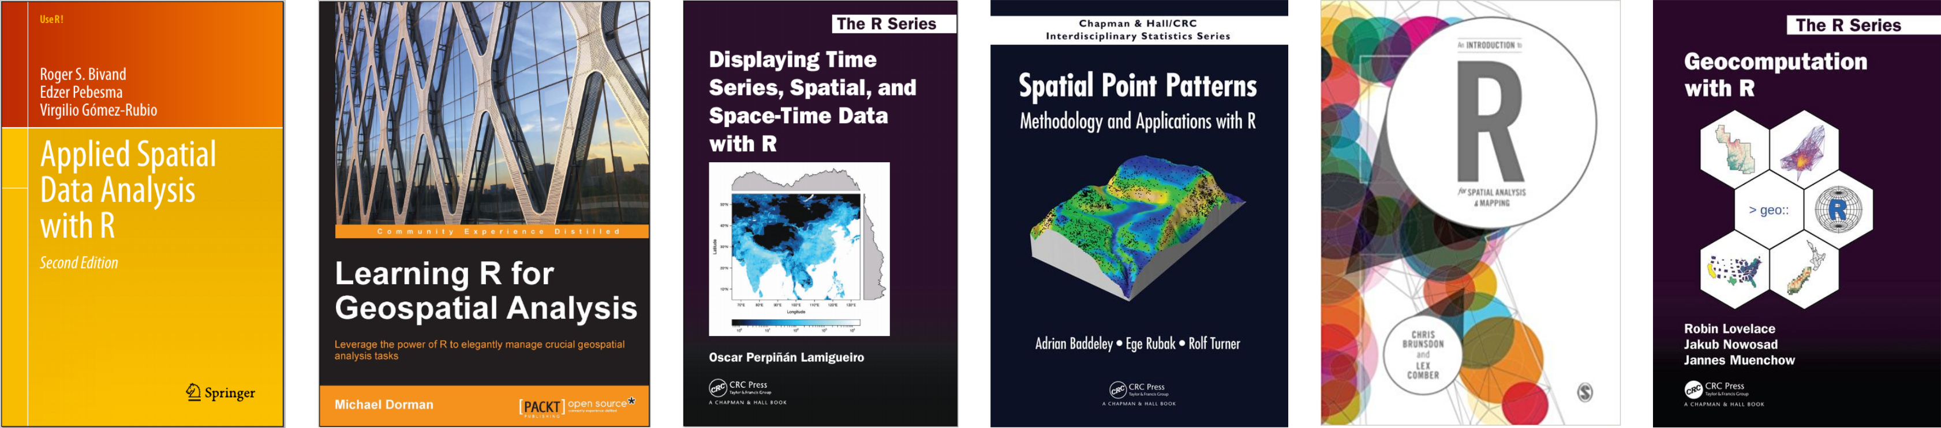
Useful resources
Source: Michael Dormann

Slide 9
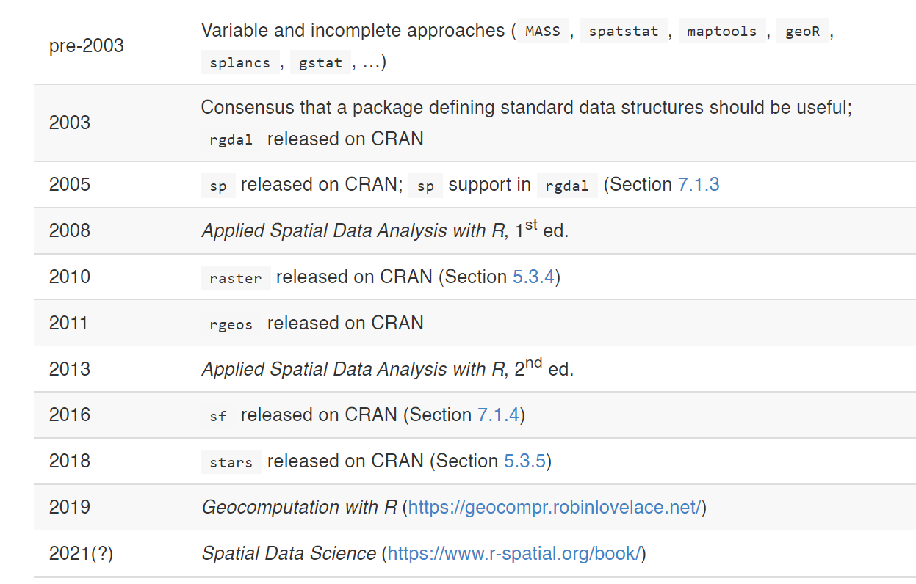
History of spatial analysis using R

Slide 10
sf is the new sp!
Spatial objects are stored as data frames, with the feature geometries stored in list-columns
All functions begin with st_ for easy RStudio tab completion
Functions are pipe-friendly
dplyr and tidyr verbs have been defined for the sf objects
ggplot2 can plot sf objects directly
http://strimas.com/r/tidy-sf/

Slide 11
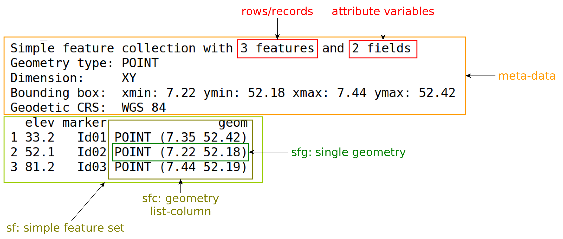
sf is intuitive
Source: https://r-spatial.org/book/07-Introsf.html

Slide 12
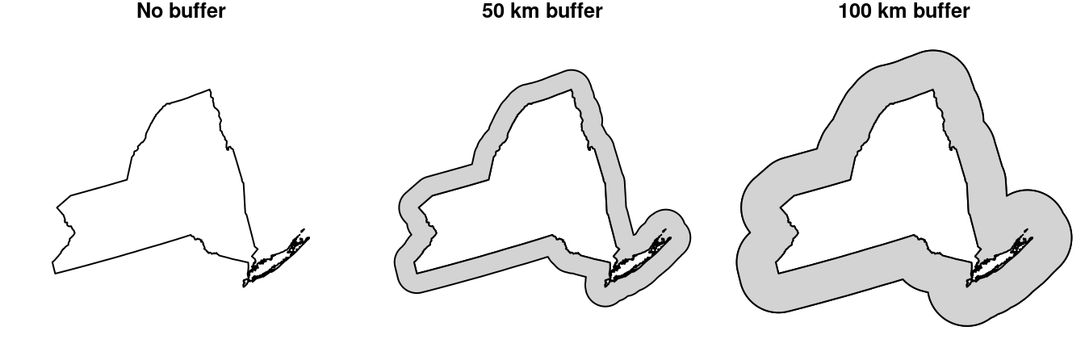
More sf functionality!
Numeric operators—Area, Length, Distance
Logical operators—Contains, Within, Within distance, Crosses, Overlaps, Equals, Intersects, Disjoint, Touches
Geometry generating operators—Centroid, Buffer, Intersection, Union, Difference, Convex-Hull, Simplification

Slide 13
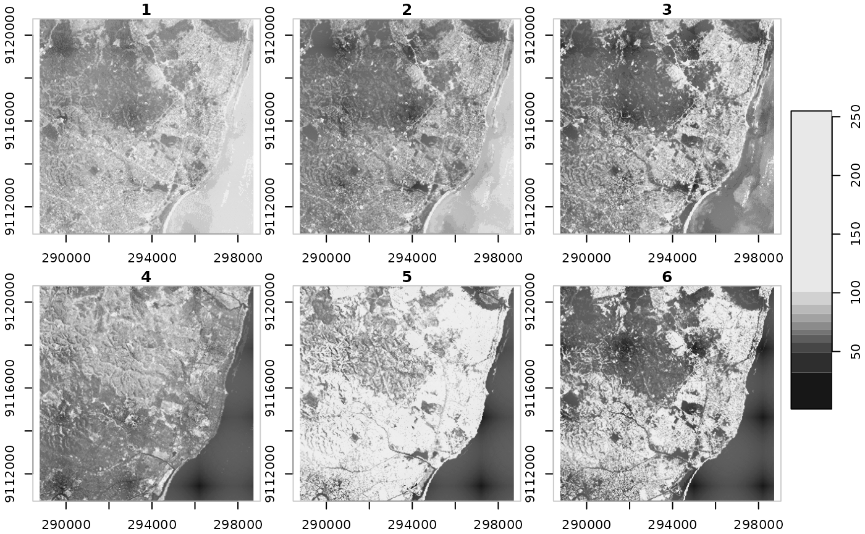
raster and stars
Accessing cell values — As matrix / array, Extracting to points / lines / polygons
Raster algebra — Arithmetic (+, -, …), Math (sqrt, log10, …), logical (!, ==, >, …), summary (mean, max, …), Masking
Changing resolution and extent —Cropping, Mosaic, Resampling, Reprojection
Transformations — Raster <-> Points / Contour lines / Polygons

Slide 14
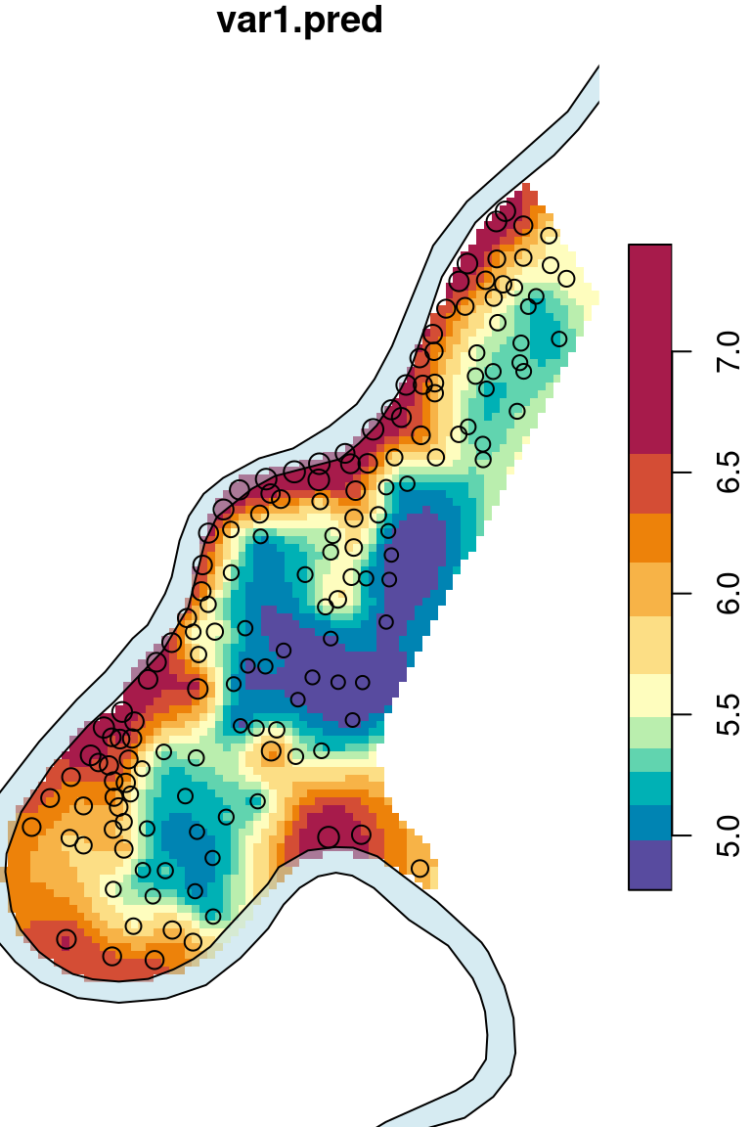
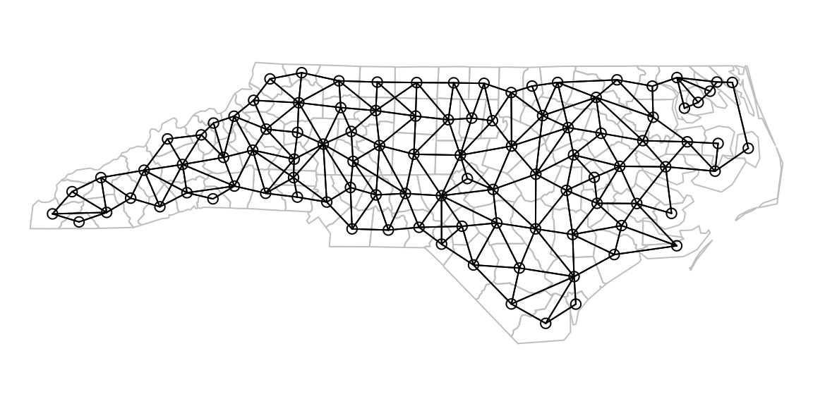
Spatial statistics – gstat, spdep, spatstat

Slide 15
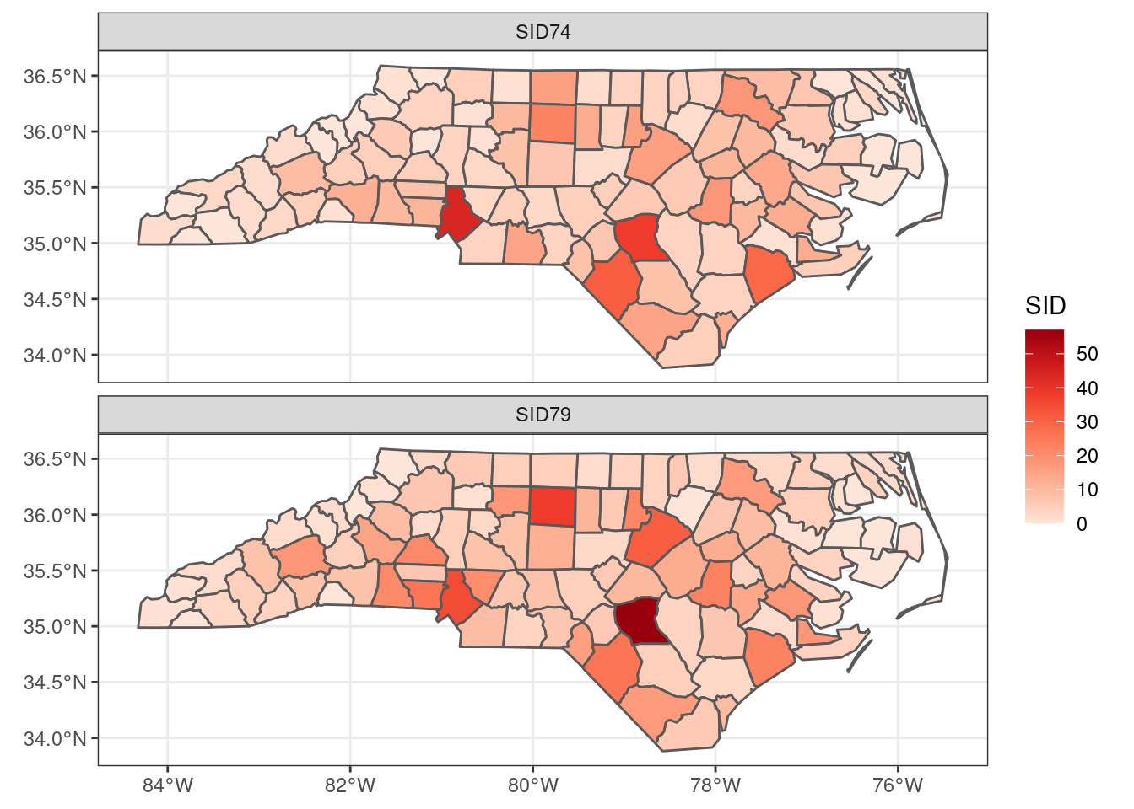
Visualization in space - ggplot2

Slide 16
Birds and Mountains
Notes:
I have been fascinated by birds on mountains for over a decade now. It was initially sparked by my first research experience where I observed birds in the High Himalayas and it made me think about the sheer diversity of birds that occurred along habitat types and elevations.

Slide 17
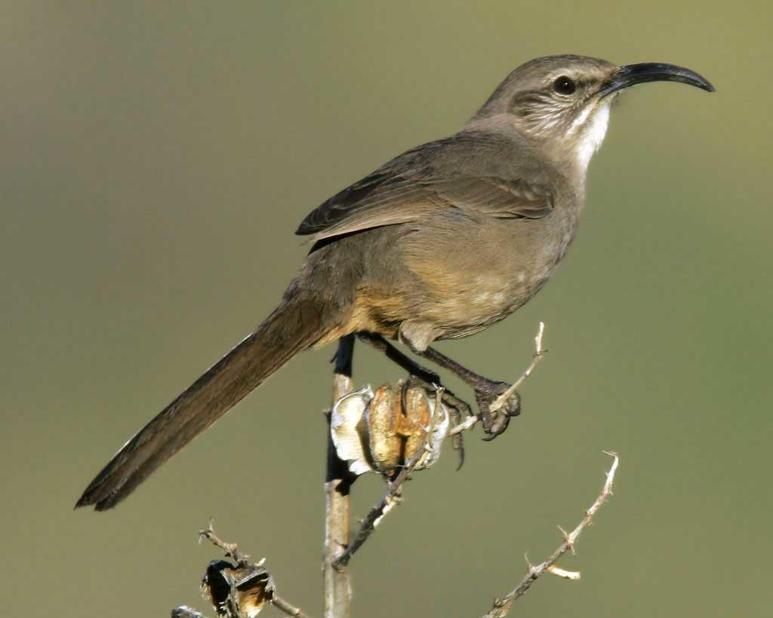
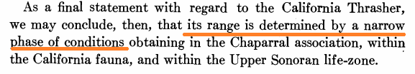
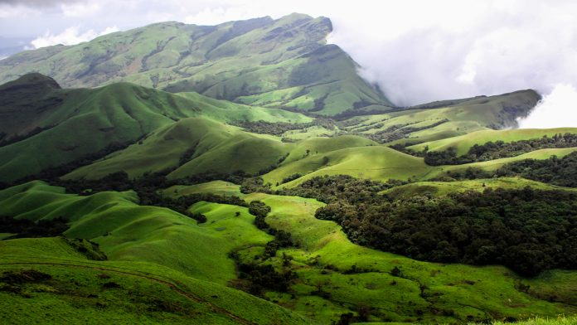
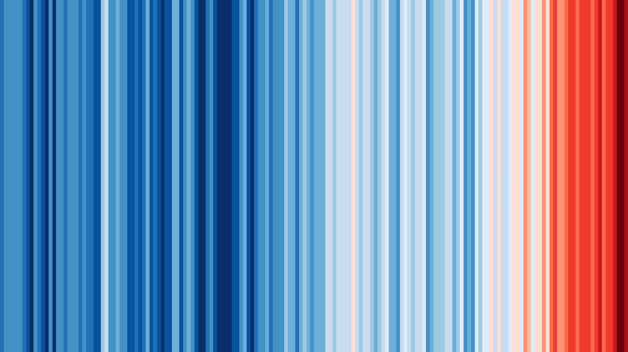
Drivers of species distributions
California thrasher
Land cover
Climate
Wallace 1876; Grinnell 1917; Gaston 2000; Image from Wikimedia Commons
Notes:
For the last several years, I have been particularly interested in understanding why certain species are distributed where they are, and the mechanisms responsible for the same. We know from early work by Joseph Grinnell and others that the environment plays a strong role in determining a species’ range. Specifically, for my dissertation, I have been interested in parsing the role of land cover and climate in structuring species distributions.
One of the long standing questions in the field of ecology is trying to disentangle why certain species are distributed where they are and the mechanisms behind the same.
Since the time of Wallace, we have known that the environment plays a key role in constraining or structuring where species are found, and some of these concepts were formalized in the early part of the 20th century. When Grinnell popularized the idea of the niche, he referred to the geographic range of the California thrasher as being determined by a narrow phase of conditions. Over the last few decades, we have started thinking a bit more about why certain global patterns exist and the mechanisms behind the same and this is something that I am fascinated by.
Almost two hundred years ago, scientists started speculating how the environment could potentially limit where a species is found. In the last century, some of these ideas have led to thinking about the niche theory as evidenced by Grinnell’s work, where he talks about a narrow phase of conditions that limit the range of the California thrasher. More recently, we have started thinking about how the environment and other mechanisms may lead to large scale patterns such as the latitudinal gradient in species richness or the effect of elevation.
Wallace: Climate appears to limit the range of many animals, though there is some reason to believe that it is not the climate itself so much as the change of vegetation consequent on climate which produces the effect.

Slide 18
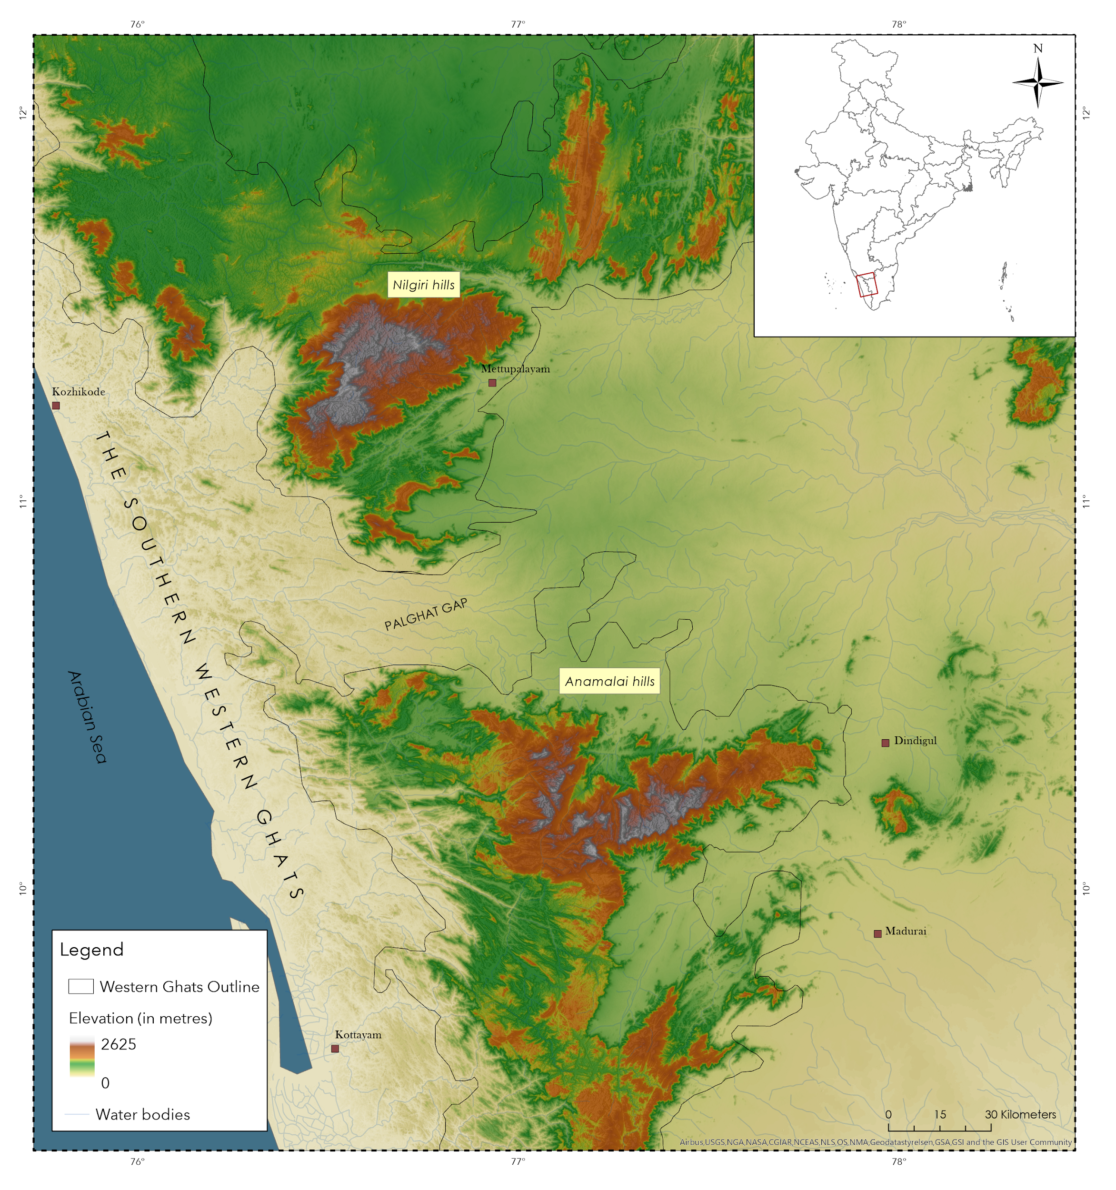

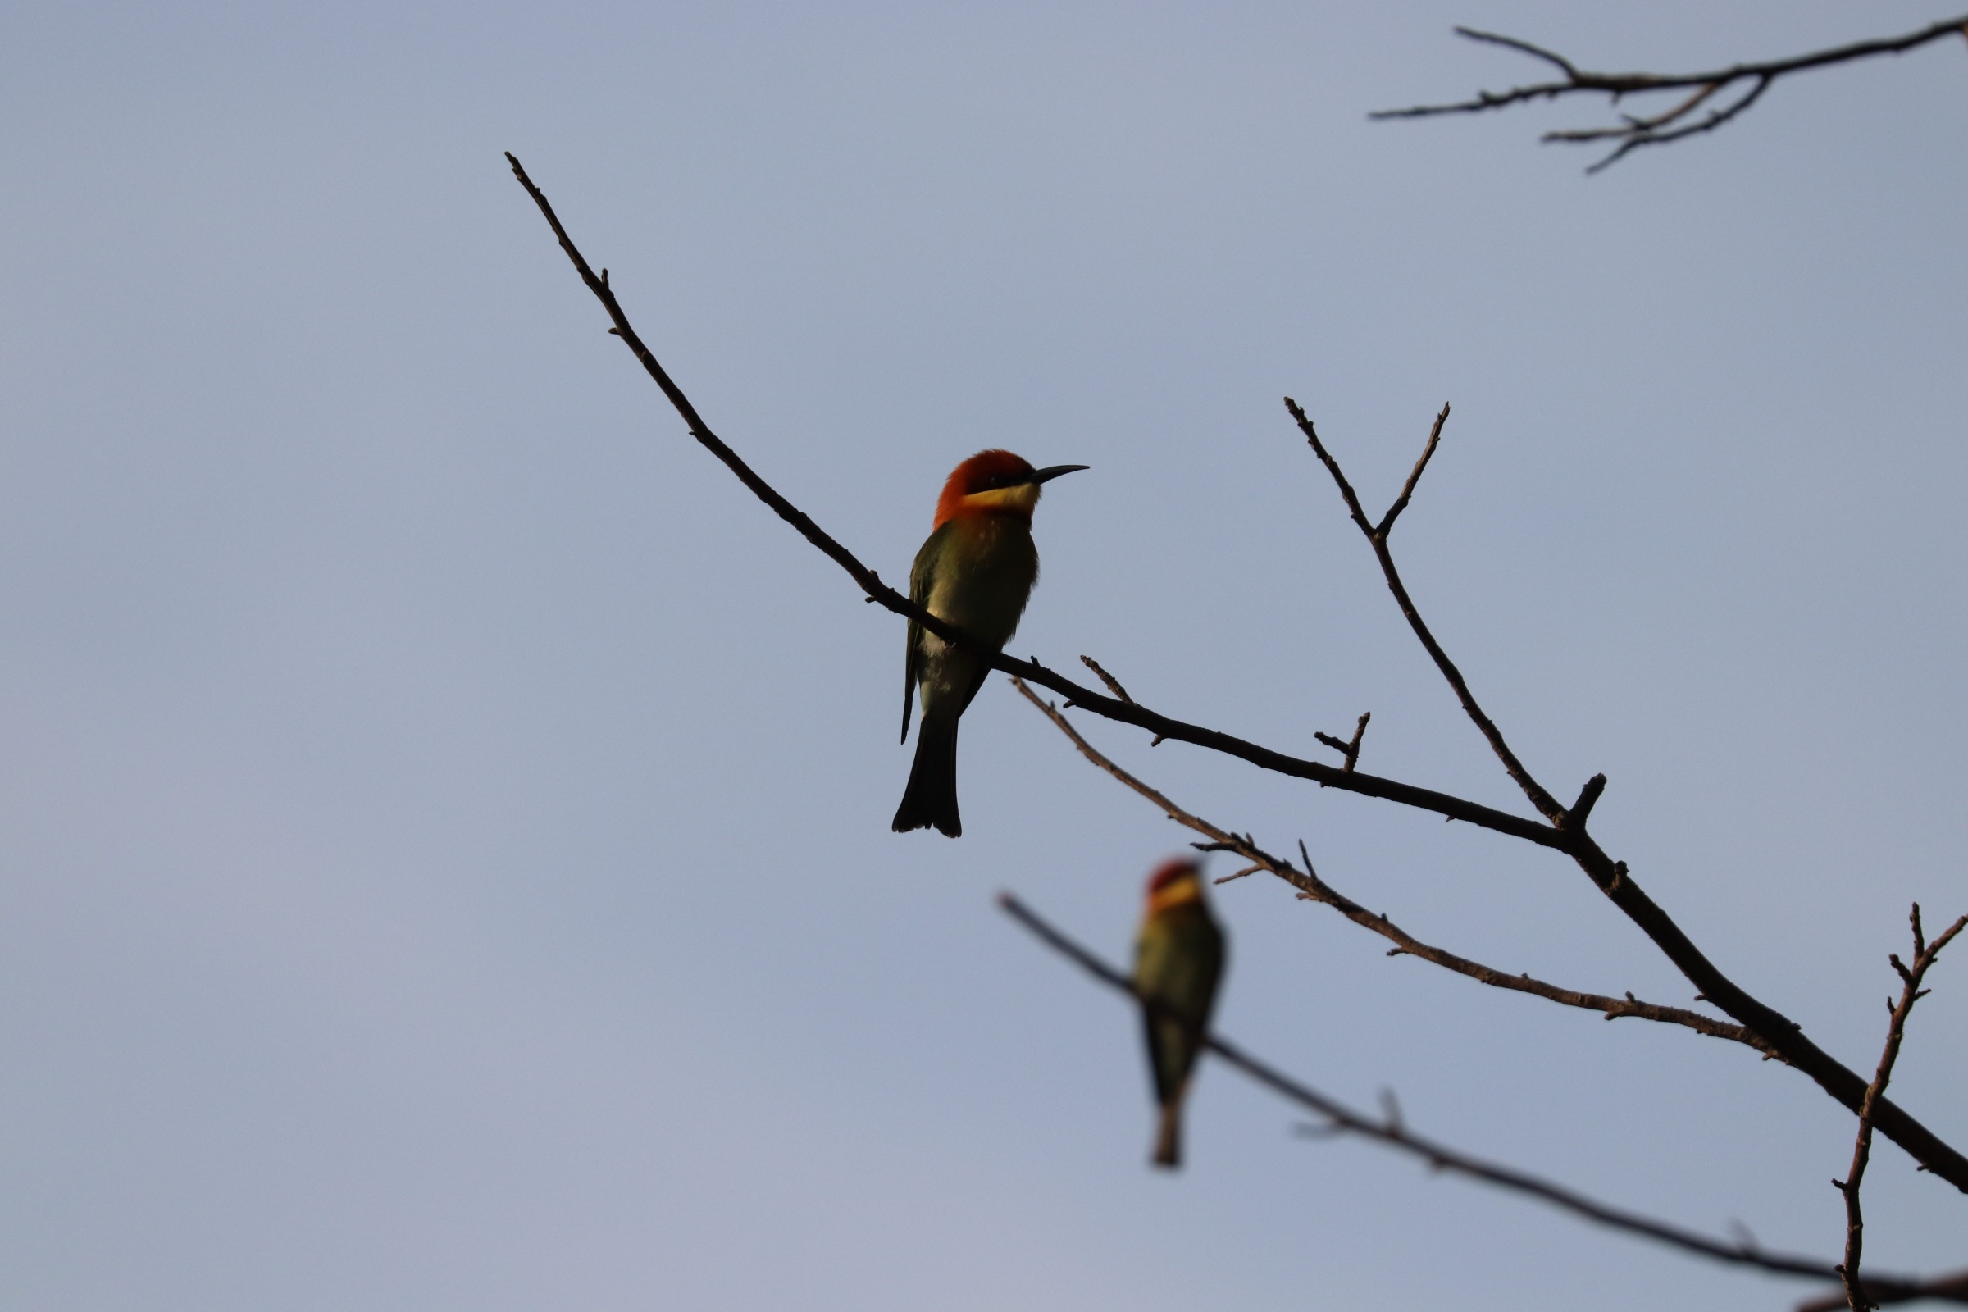
The Western Ghats
Topographic complexity
Anthropogenic changes
Birds - an ideal model
Indian scimitar-babbler
Chestnut-headed bee-eater
Arasumani et al., 2019
Notes:
I will focus on the southern western ghats, which has been recognized as a global biodiversity hotspot, and is home to numerous endangered and endemic species of plants and animals. For the first three chapters of my dissertation, I will focus on the Nilgiris, the Anamalais and the Palanis. A region that is undergoing rapid loss of suitable habitats, and increasing number of extreme events. In addition, this area is topographically complex shown here by an elevational profile going from the southern Wg to the northern wg (the big biogeographic barrier is visible here). I will focus on birds, as they are an ideal system with sufficient datasets, and are found across habitats and elevations.

Slide 19
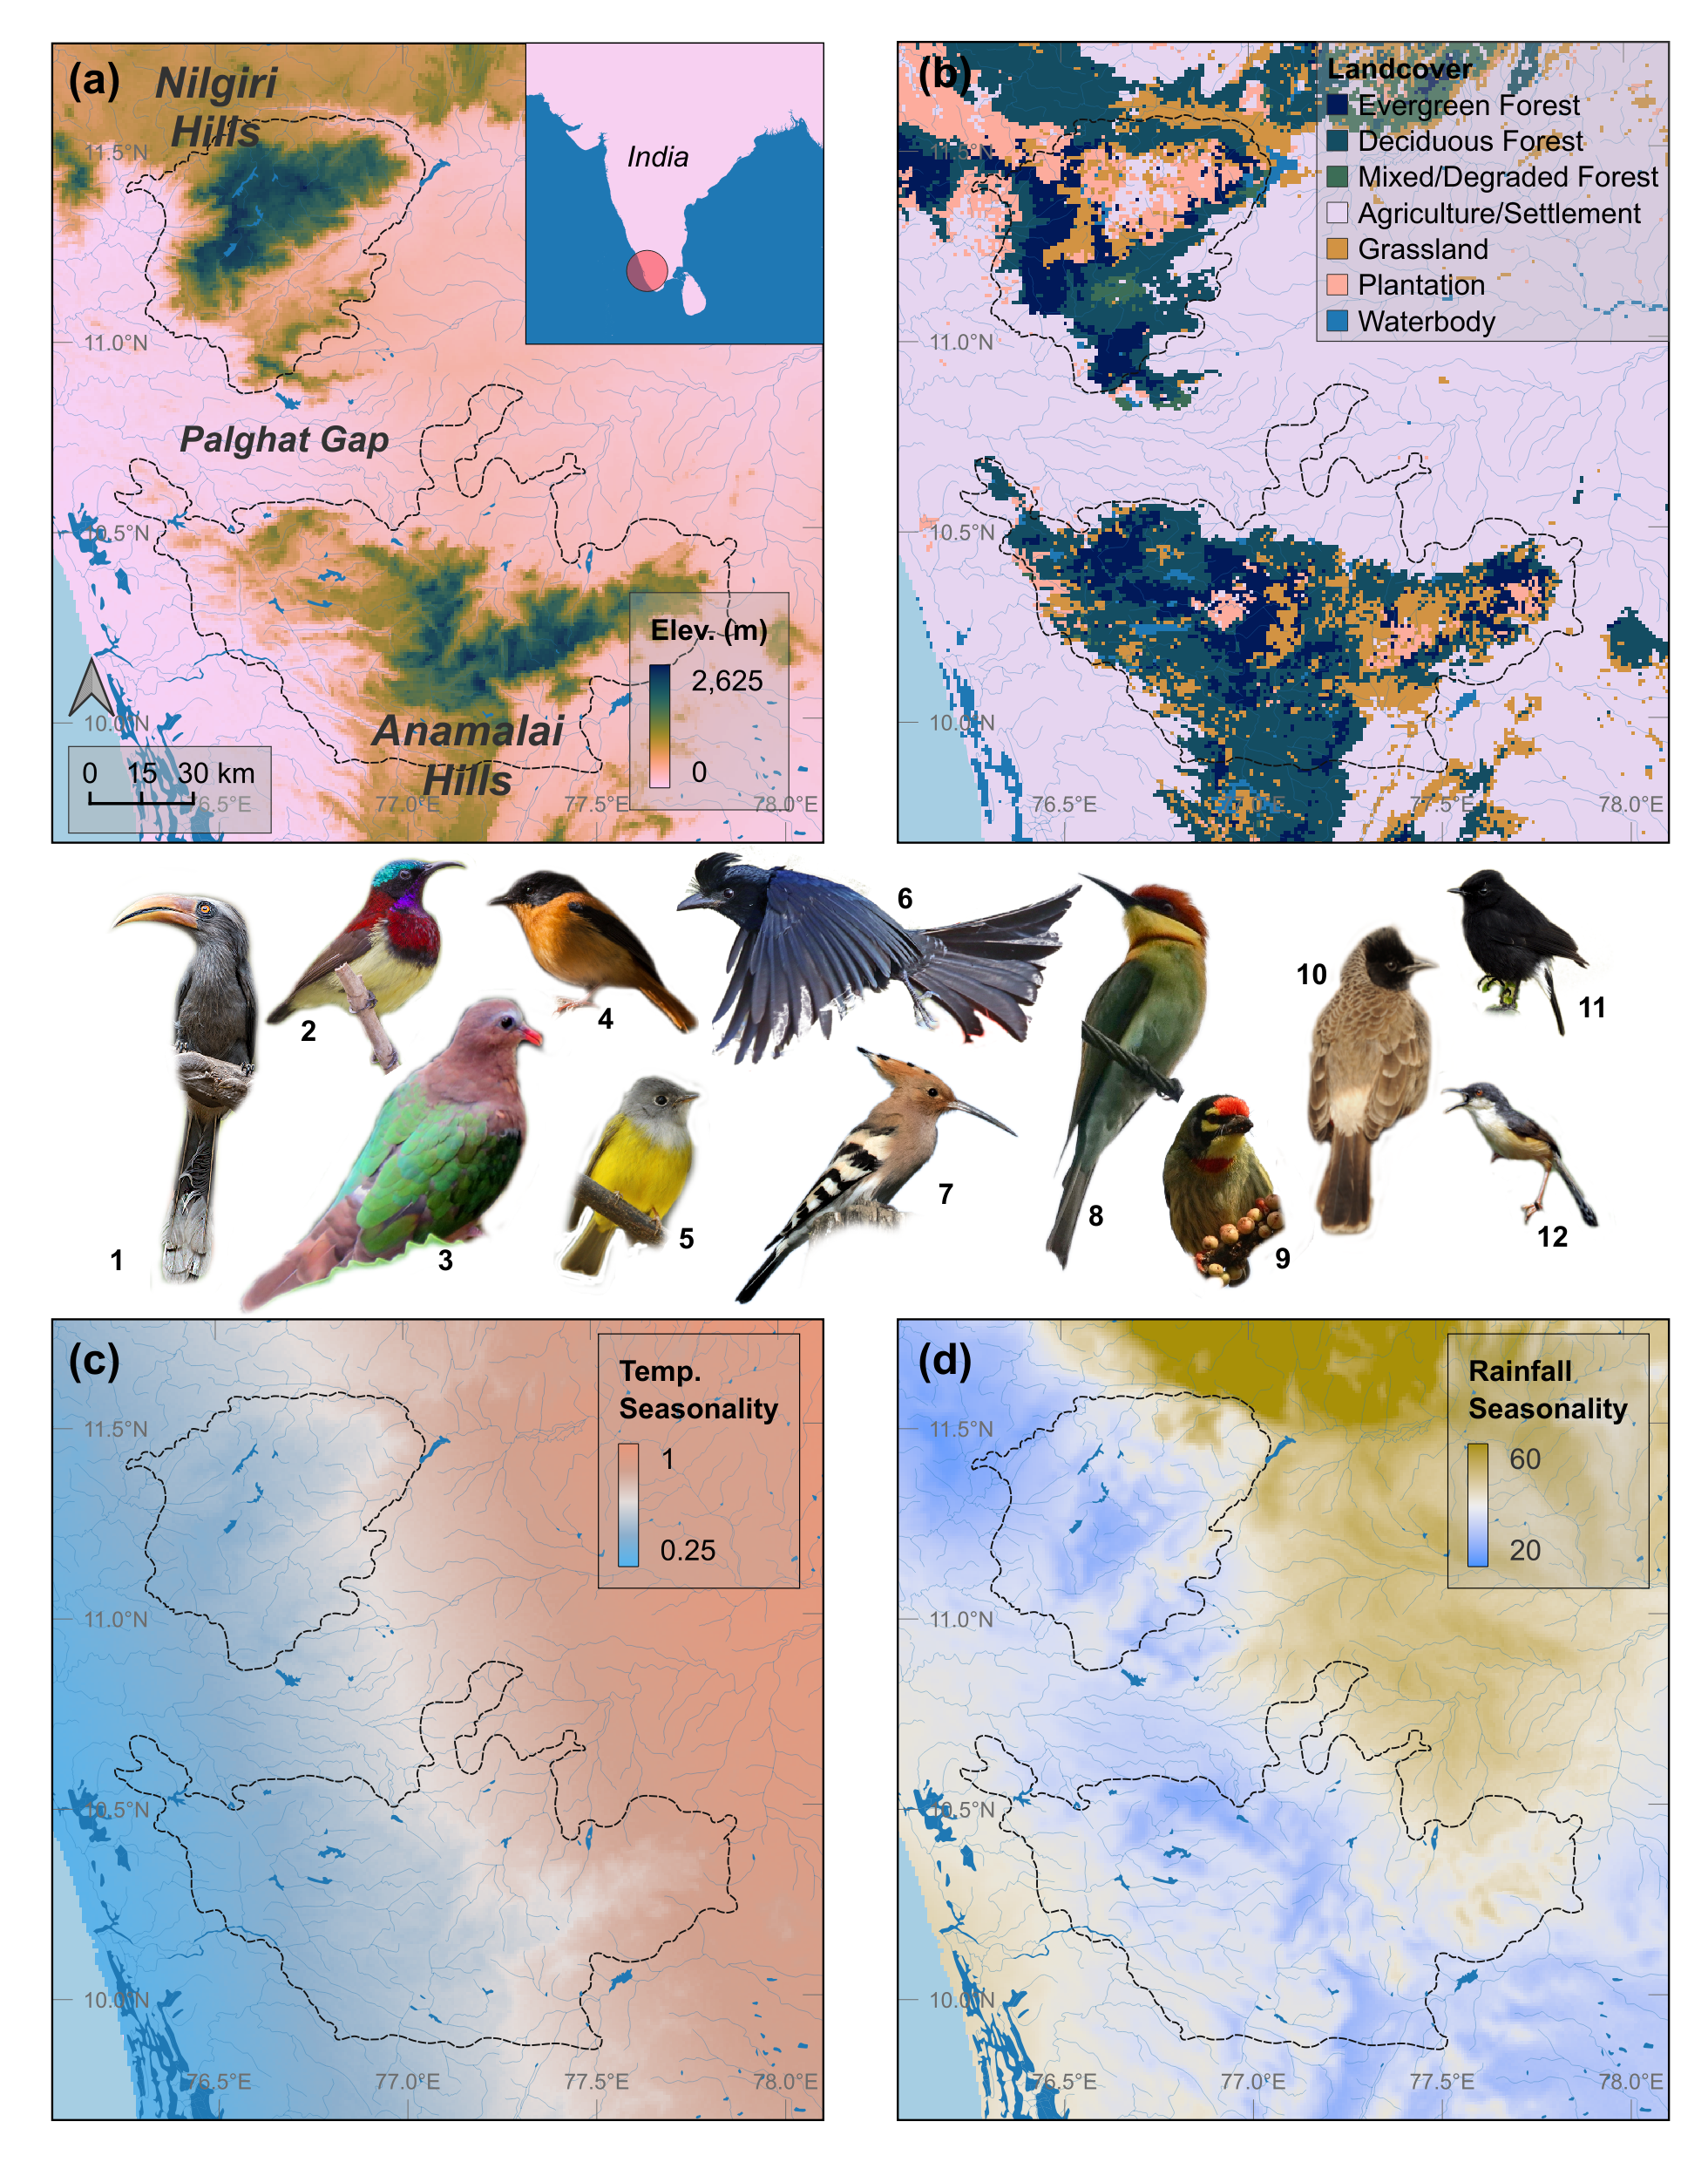
Tropical birds have evolved in climatically stable regions
Environmental changes
Human-modified tropical landscapes
Janzen 1967; Stevens 1992; Chan et al. 2016

Slide 20
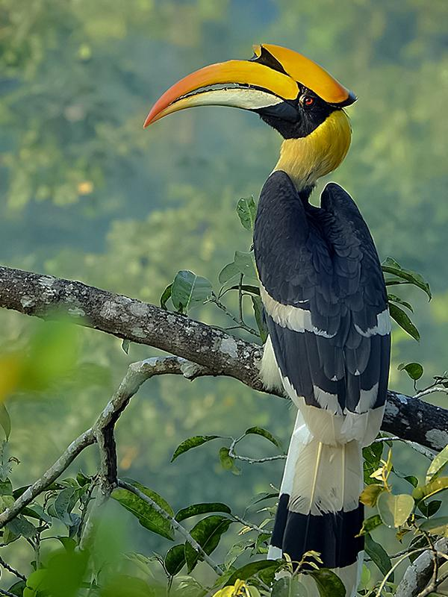
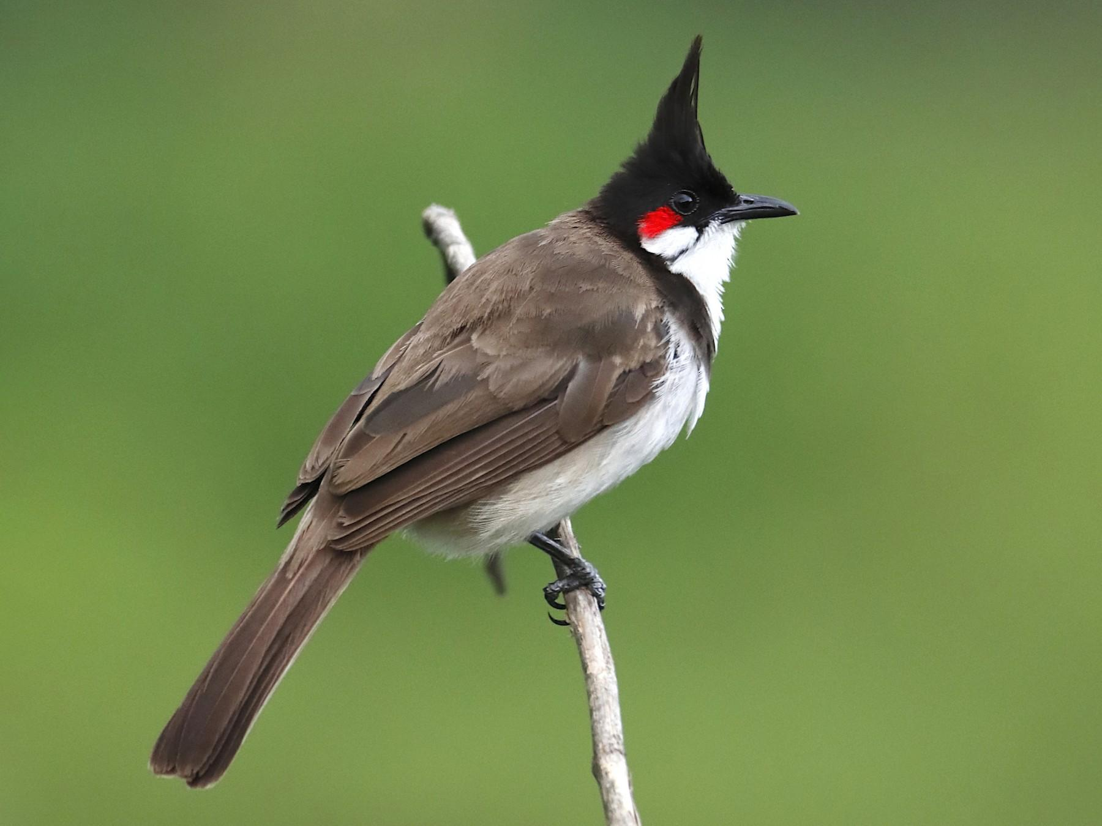
How are climate and land cover associated with bird species occupancy?
Temperature and precipitation seasonality
Prop. of land cover
~ 14 million observations across 1342 species
(as of Mar 2021)
Great hornbill
Red-whiskered bulbul

Slide 21
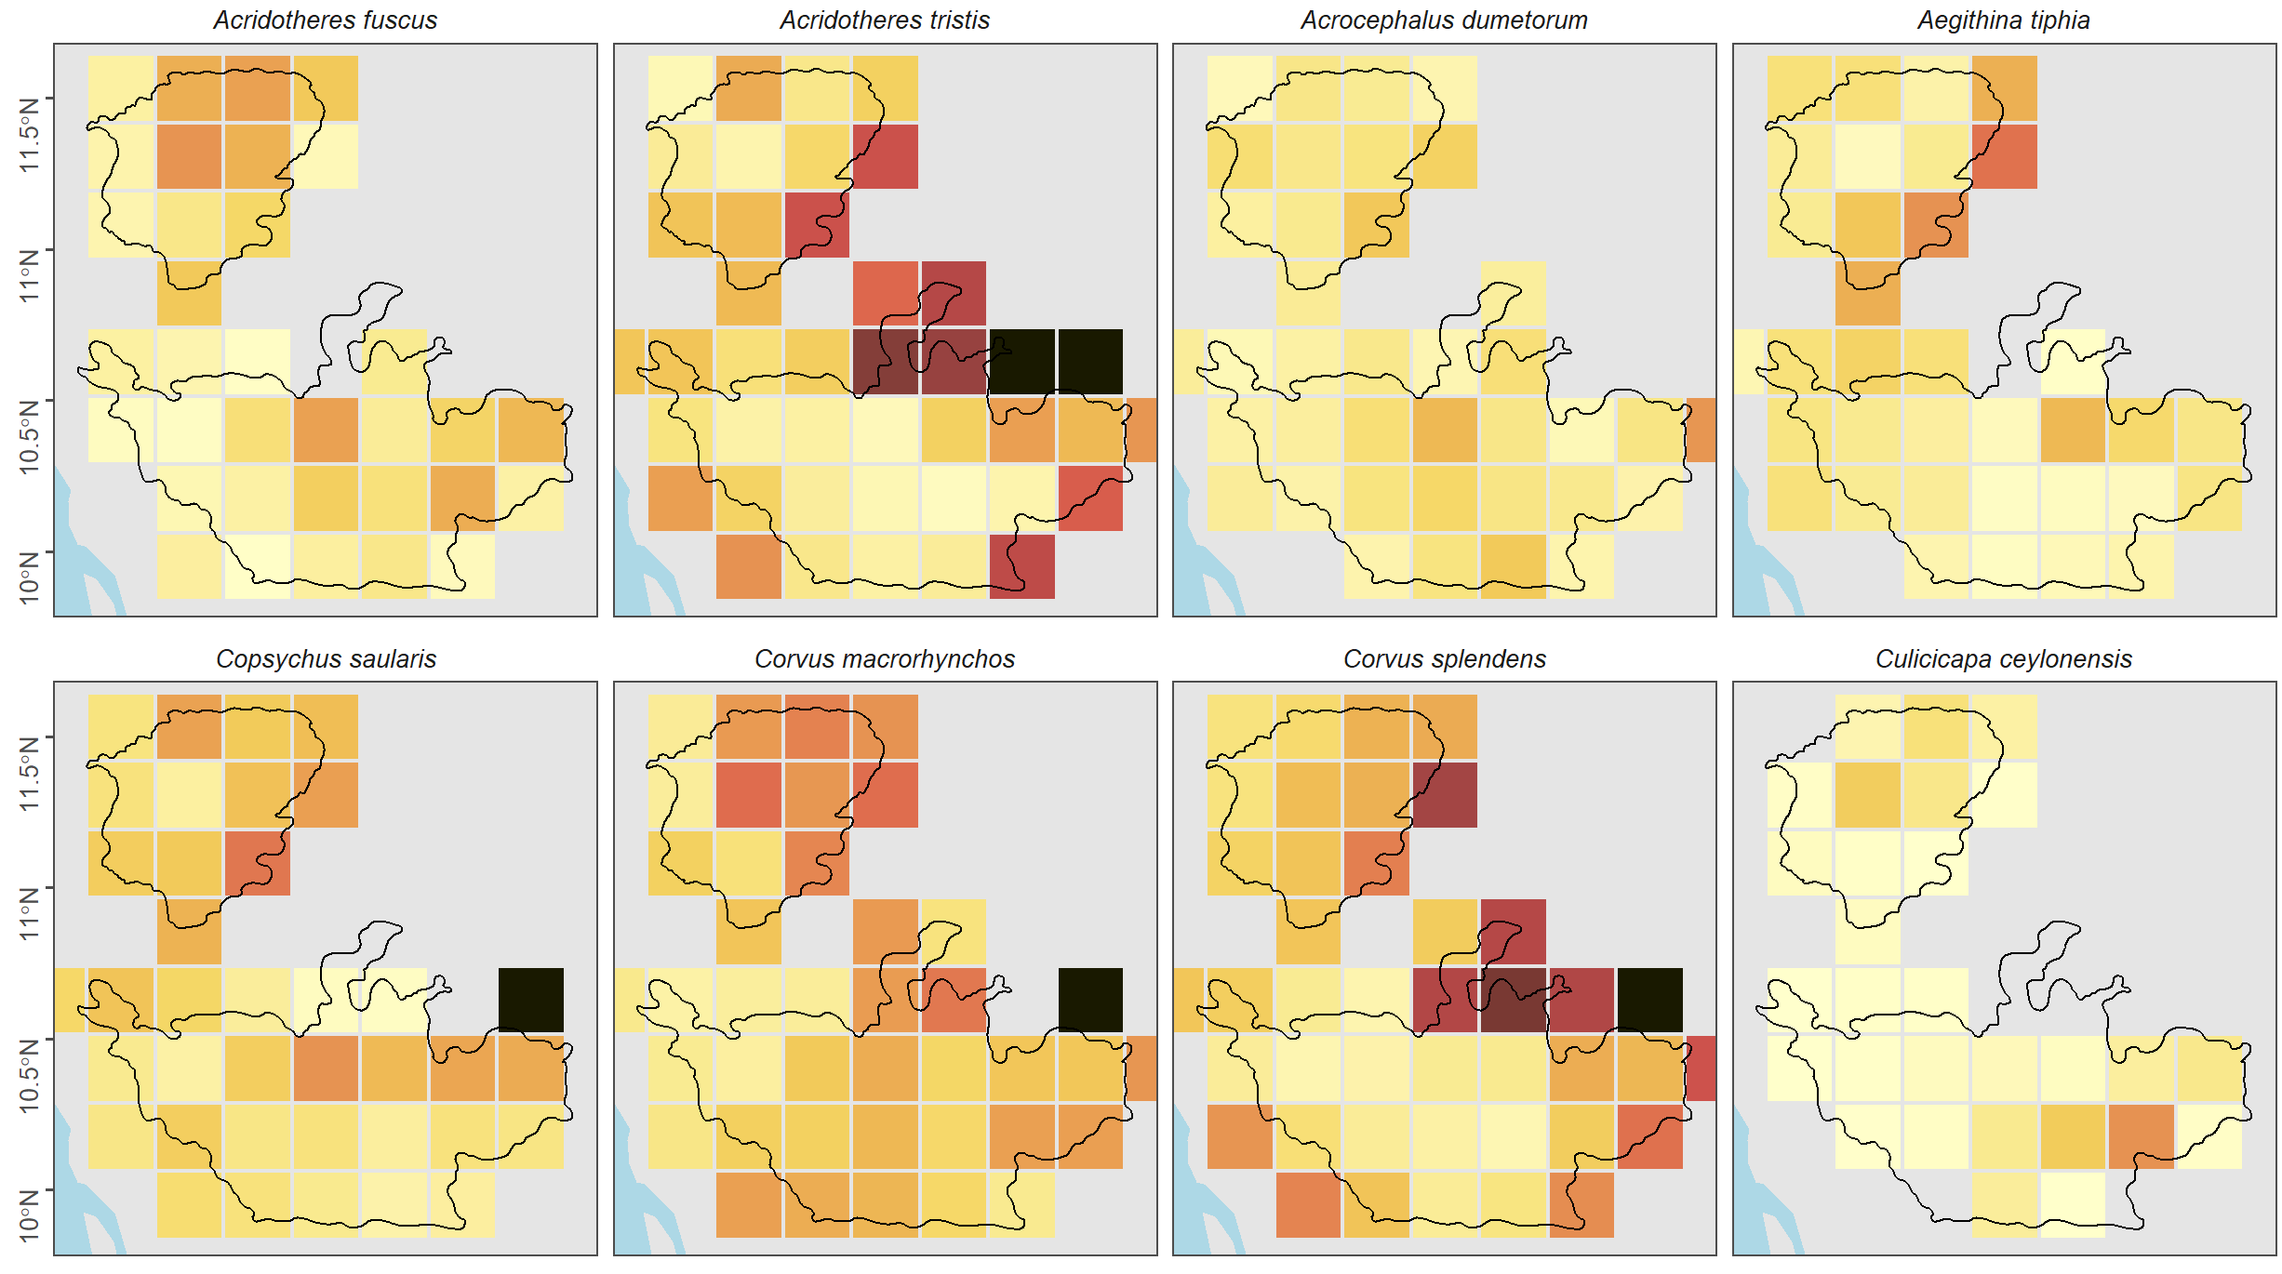
What can you do with eBird data?
Proportion of checklists that report species X

Slide 22
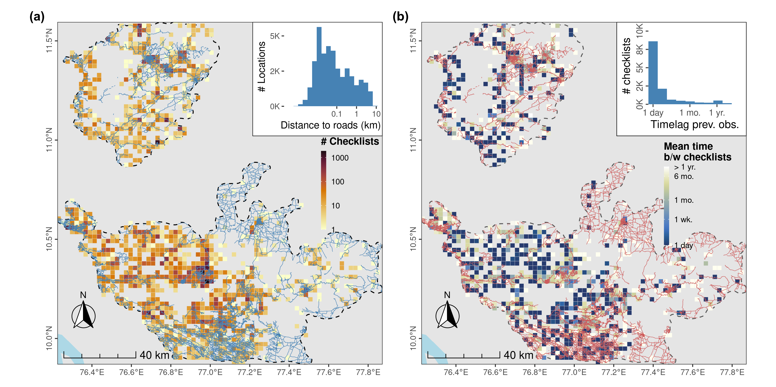
Examine spatial and temporal biases

Slide 23
Adjusting for spatial precision - eBird
Spatial coordinates not accurate in many cases:
Majority are traveling checklists
Large proportion assigned to a hotspot
To account for the above:
Used a minimum grid size of 2.5km by 2.5km to account for survey effort (see Johnston et al., 2019)
Other stipulations:
Only complete checklists
Traveling checklists (dist <5 km, duration <5 hrs, <10 observers)
Absence data (by zero-filling; Strimas-Mackey et al., 2018)

Slide 24
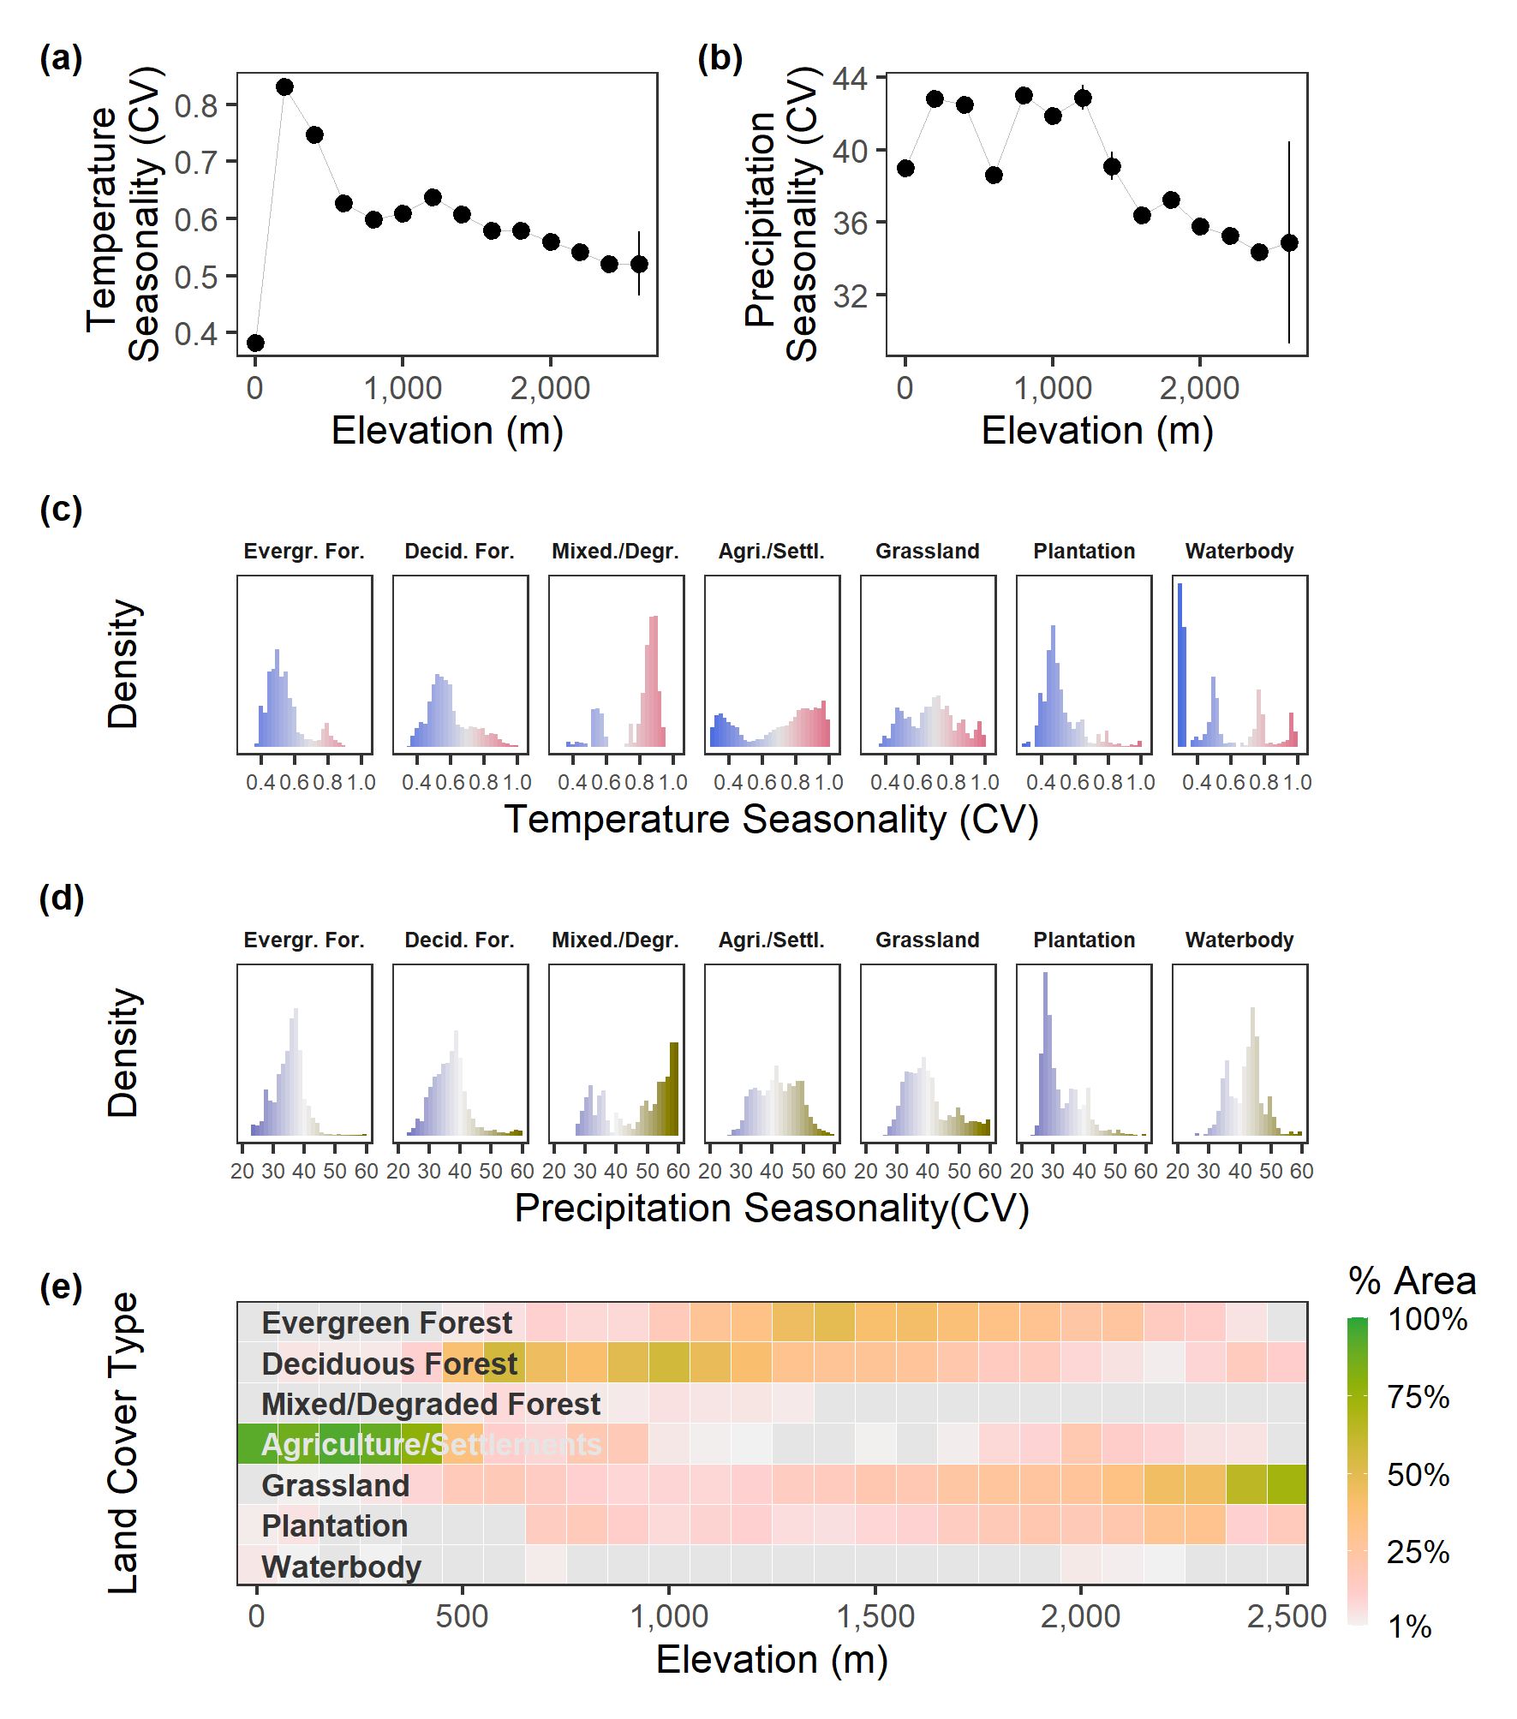
Examining environmental data

Slide 25
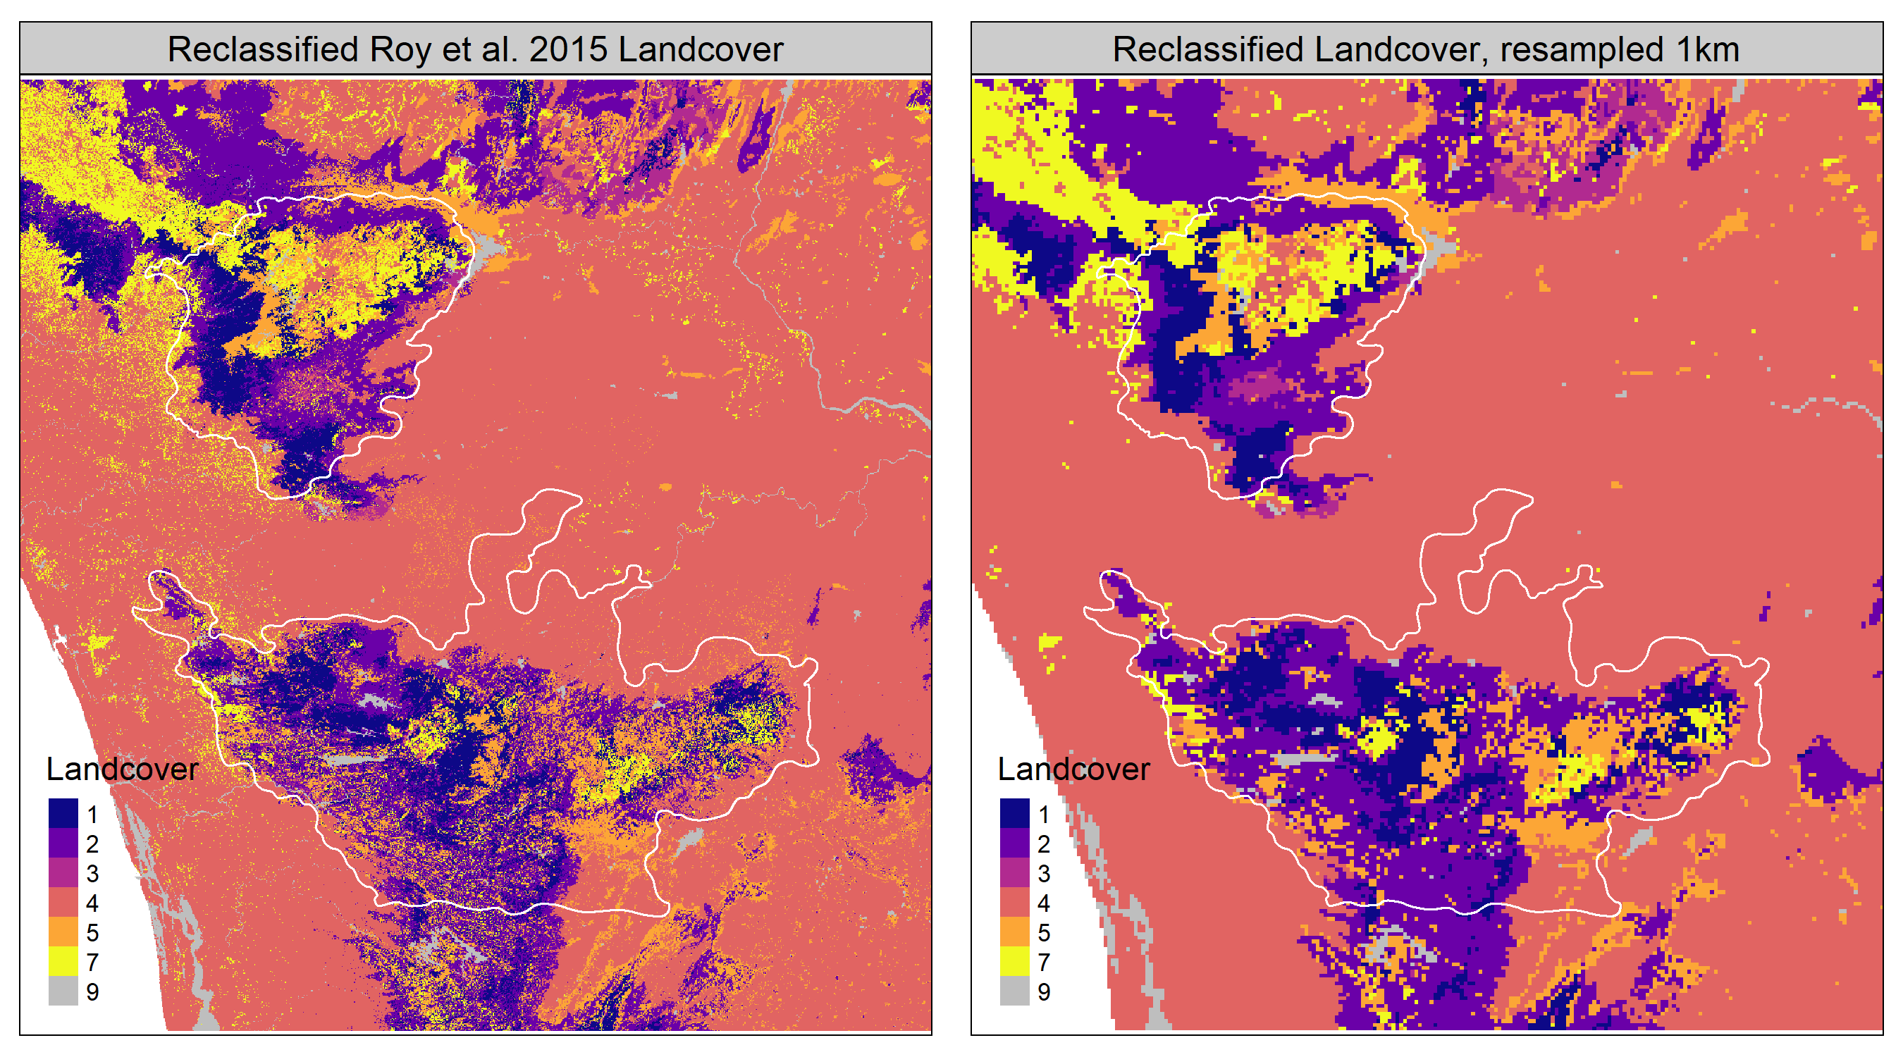
Google Earth Engine + R

Slide 26

Occupancy modeling
Occurrence: ~140 species of birds chosen from eBird (2013-2020)
Detection covariates: duration, Jdate, nObs, dist, expertise, protocol, startTime
Site-level covariates^: landCover (6) and climate (2)
Multi-model information-theoretic approach
Data sources:
CHELSA (1km)
Sentinel (10m)
SRTM (30m)
^Total number of covariates, after accounting for multicollinearity (Dormann et al., 2013)
Johnston et al., 2017; Keeling et al., 2015; MacKenzie et al., 2017; Burnham and Anderson 2002
Notes:
The idea behind an occupancy modeling framework is that the true state/ probability of occupancy is a function of environmental drivers as well as our ability to detect where a particular species is found. Keeling et al., (2015) - expected number of species that an observer would record during a standardised search of the habitat. I used single-season occupancy models as proposed by MacKenzie et al., (2006)

Slide 27
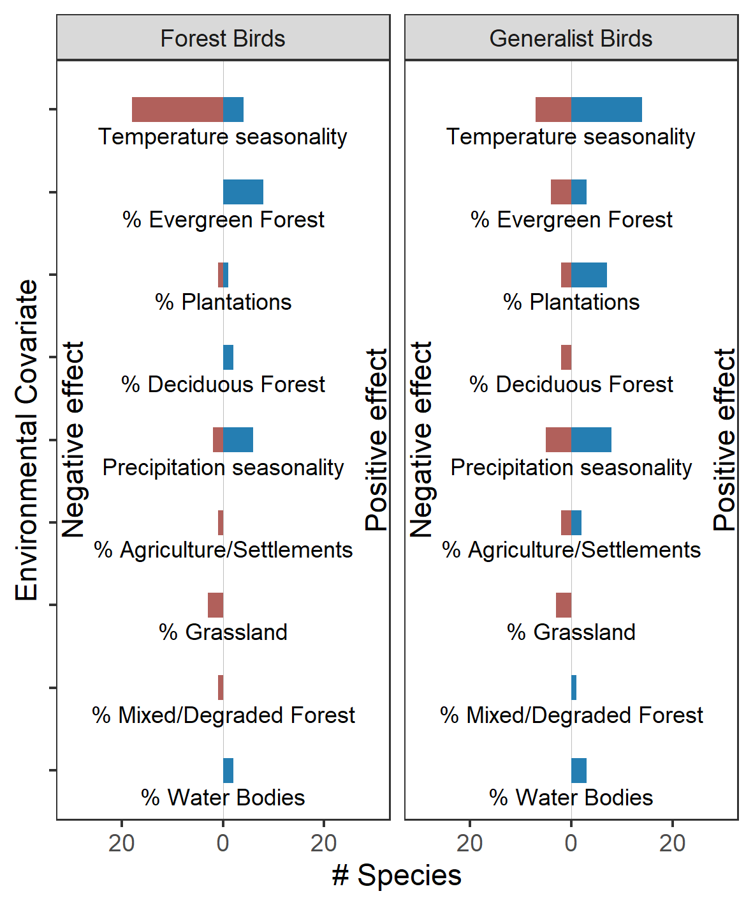
Species-specific associations
Forest specialists are negatively associated with temperature seasonality
Generalist species are showing a positive association with temperature seasonality
Human-modified land cover types are positively associated with the occupancy of generalist birds

Slide 28
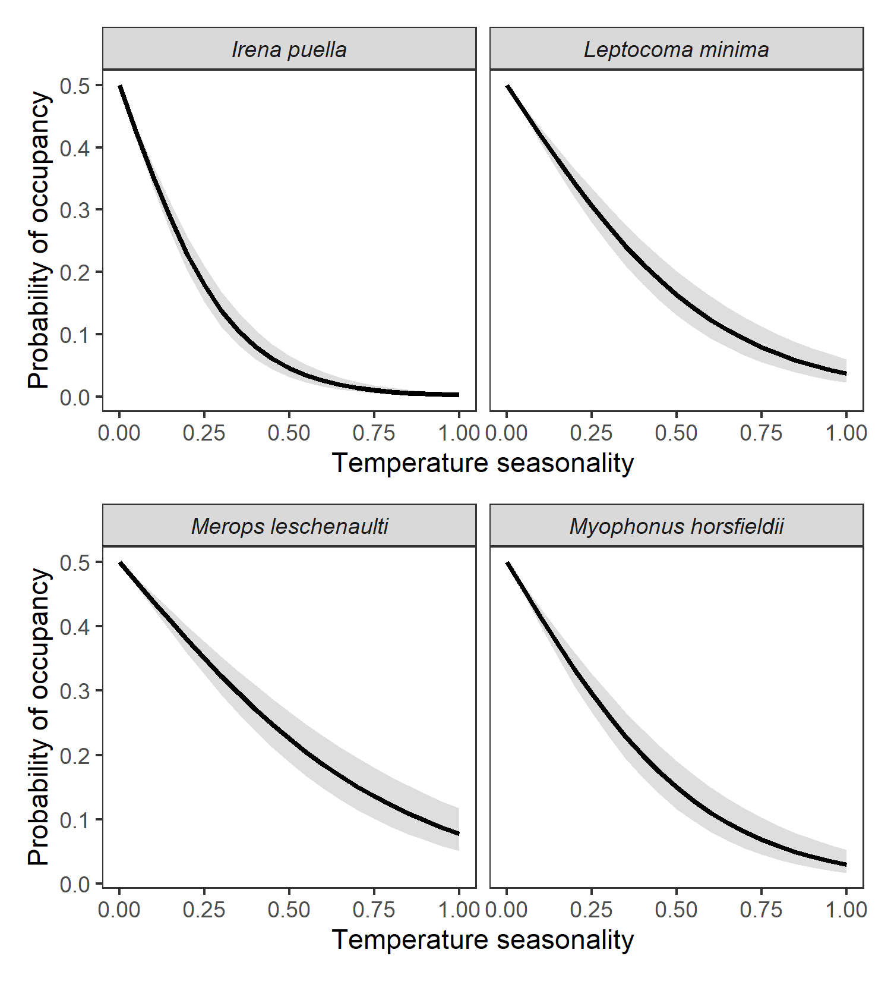

Slide 29
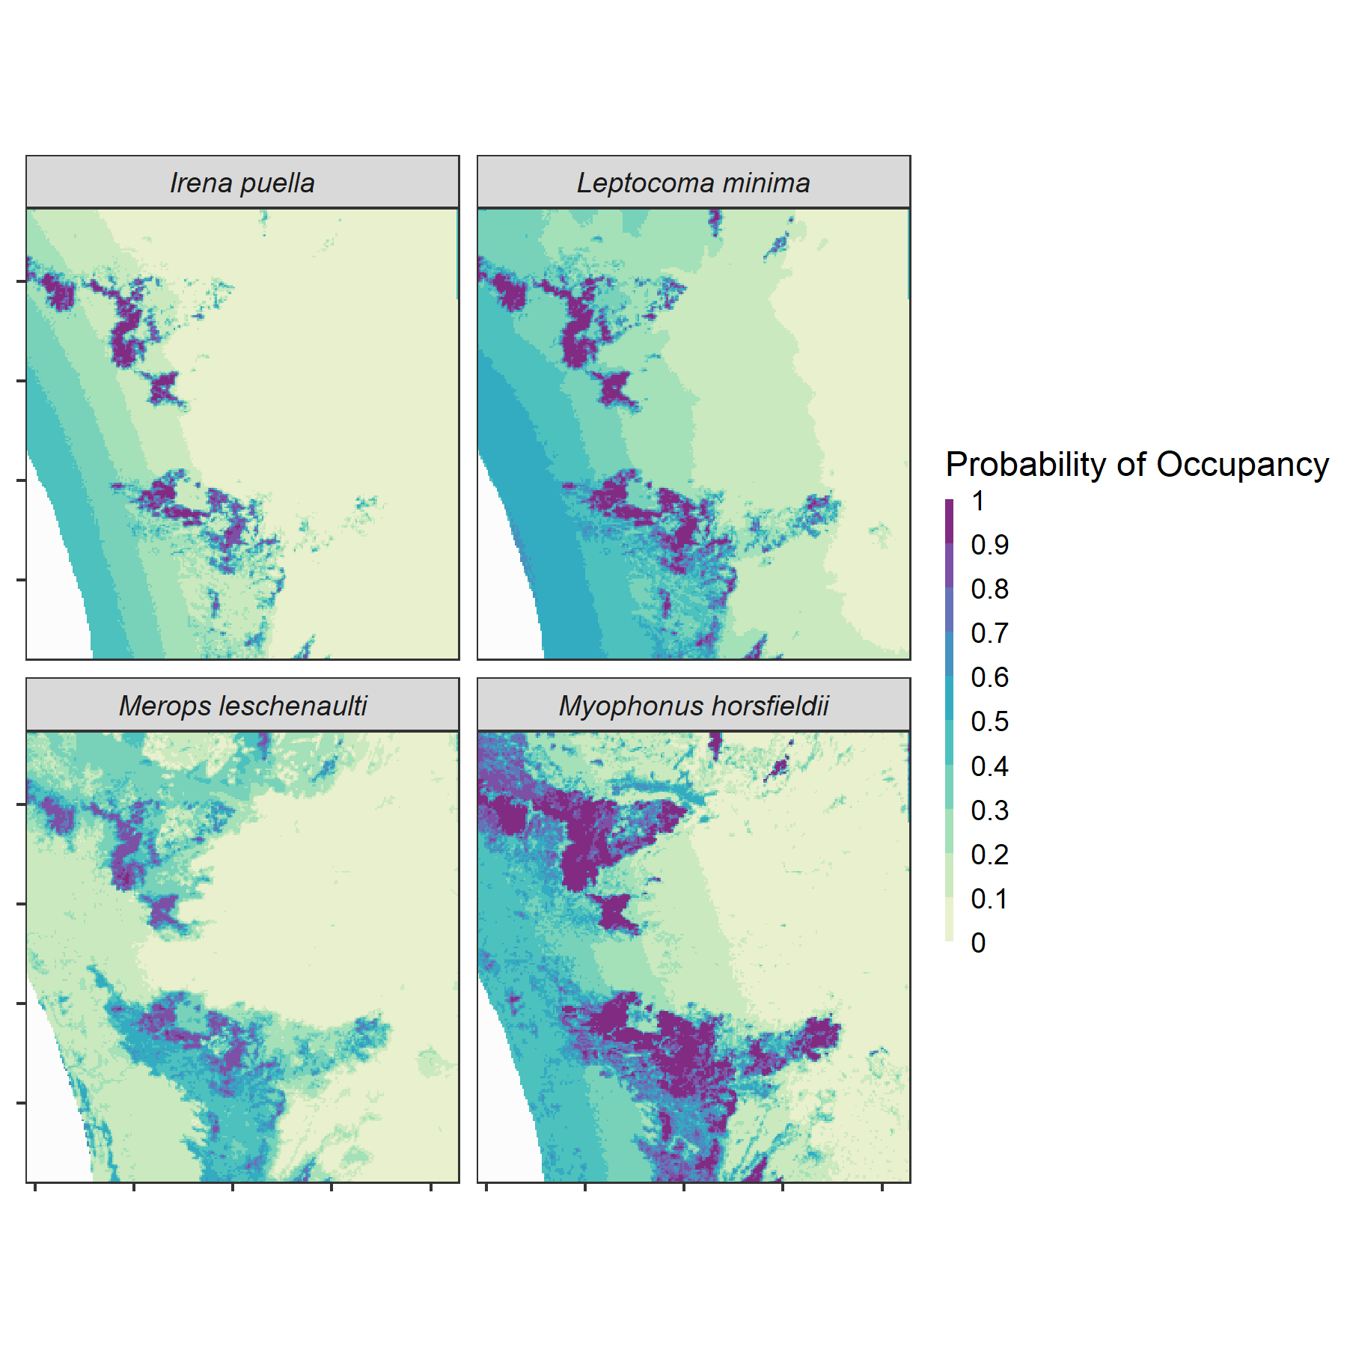

Slide 31

Summary
Tropical montane birds are negatively associated with temperature seasonality
Naturally occurring land cover types are critical to sustaining avifauna
Robustly filtered citizen science data can be used to obtain a nuanced understanding of bird distributions
Reproducibility

Slide 32


Reproducibility
Transparency in research
Promoting inclusivity and reducing barriers to access
Testing accuracy of your methods
Field reproducibility is not always possible
Computational reproducibility is!

Slide 33

Version control
keep the entire history of a file
tag particular version so you can go back to them easily
facilitates collaborations and makes contributions transparent
experiment with code and feature without breaking the main project

Slide 34
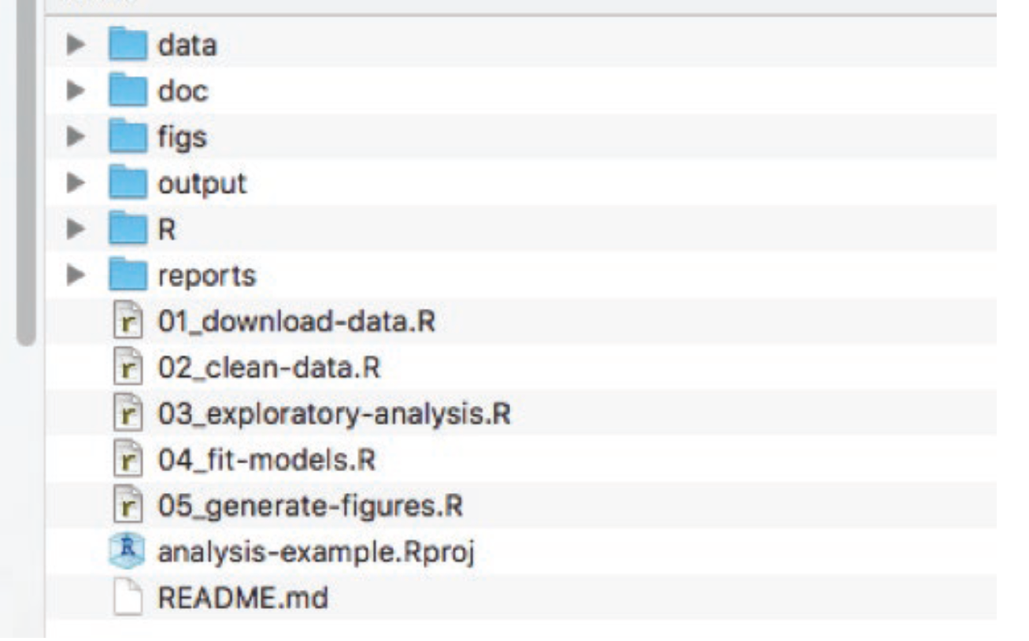
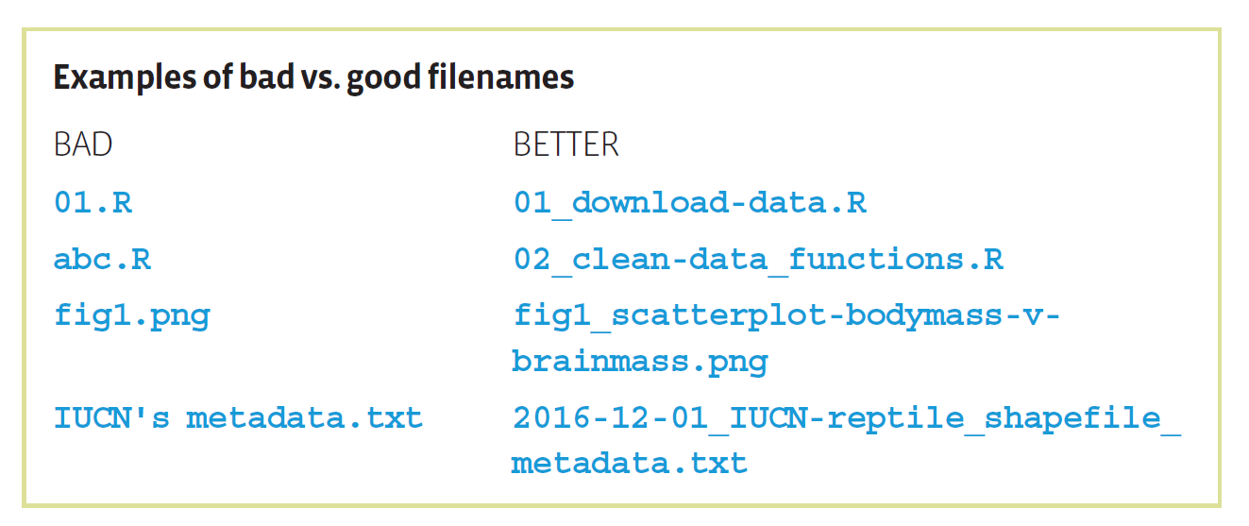
Best practices for a reproducible project

Slide 35
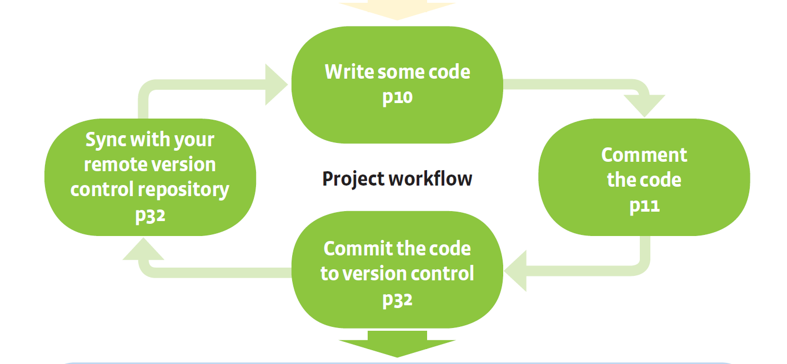
BES Guide to Reproducible Code
https://www.britishecologicalsociety.org/wp-content/uploads/2017/12/guide-to-reproducible-code.pdf

Slide 36
GitHub
A platform to store code, data (limited amounts) and version control
Each project that is created on this platform is called a repository
Terms: commit, push, pull, fork…. (can be confusing)

Slide 37
Create a GitHub account
It’s free!
Create a username and p/w and login to your GitHub account
https://github.com/

Slide 38
Have you installed git on your system?
https://happygitwithr.com/install-git.html
Download and install the appropriate version for your corresponding OS

Slide 39
Let’s create a repository
Make a repo on GitHub
Clone it to R/Rstudio
Write code
Commit/push/pull etc.

Slide 40
if time permits
Let’s take a look at 01_simple-feature.Rmd

Slide 41

Acknowledgments and resources
Arundhati Das
Matt Strimas-Mackey
Bhaskar VK
Reproducible research - https://learning.nceas.ucsb.edu/2019-11-RRCourse/index.html
Install Git with R - https://happygitwithr.com/install-git.html
R-Spatial - https://r-spatial.org/book/08-Plotting.html
Geocomputation with R - https://geocompr.robinlovelace.net/spatial-class.html

